Slide 1
HCDI10000
Introduction to Library Resources
Notes:
Hello, my name is Claire and I am one of the Teaching and Learning Librarians at the University of Manchester. We realise things are a little bit different this year, however we hope these PowerPoint slides and the accompanying resources on Blackboard are useful to you. Please be assured that you can contact us individually for support when you need it using the links indicated in these resources.

Slide 2



What we will cover
Searching for information
Using library resources
Skills support from My Learning Essentials, My Research Essentials and Specialist Learning Support
Notes:
Today’s session will look at:
Searching for information
Using library resources
Skills support from My Learning Essentials, My Research Essential and Specialist Learning Support

Slide 3
Library resources – searching for information
Library Search
Subject Guides
Further support
www.manchester.ac.uk/library
Notes:
When you are ready to research your topic area take a look at the Library webpages. These house all the core resources in one central place. You will find Library Search, specific subject pages and information telling how you can access further support ; www.manchester.ac.uk/library

Slide 4
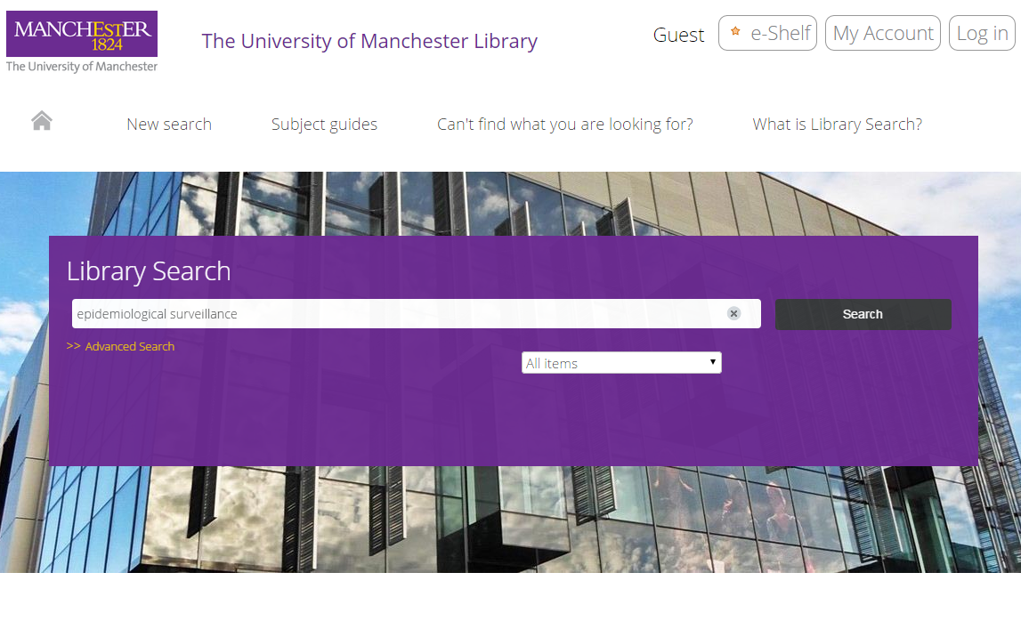
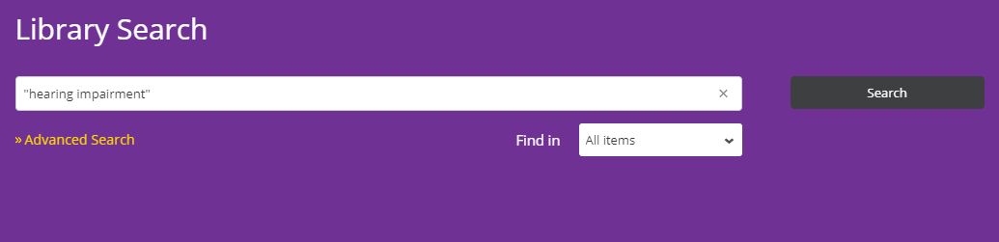
Library Search – accessing resources
Notes:
Library Search searches the Library’s physical and digital collections, as well as a number of other repositories. It provides more options to narrow your results by year, publication type etc..

Slide 5





What can Library Search do?
Search books, journals, database abstracts
Save items to your e-shelf
Email references to yourself and others
Export references to Endnote, Mendeley etc.
Copy a reference in your required citation style
Notes:
These are the core functionalities of Library Search – you can do more with it than just search for books and journal articles

Slide 6
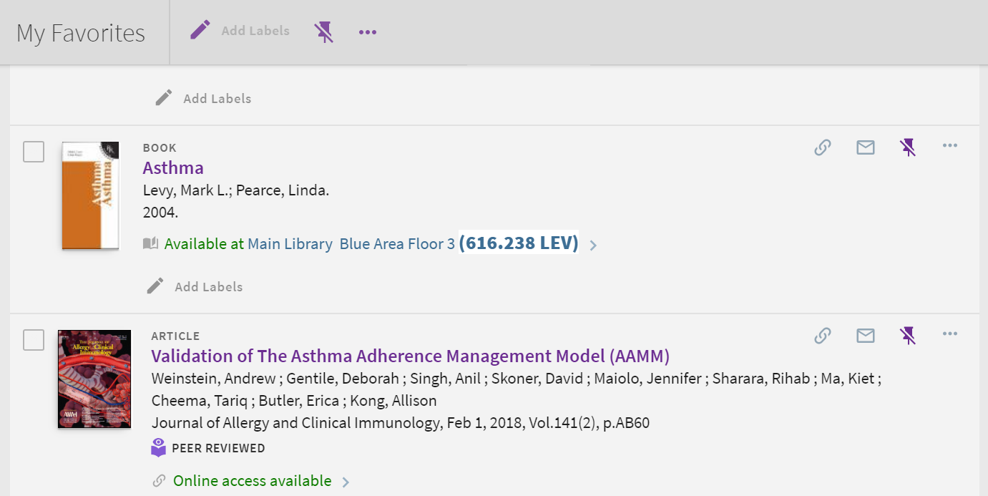
Library Search - locations and other tools
Slide text
Notes:
We are mindful that access to the library could be restricted during the ongoing Covid-19 pandemic however the library is offering a Click and Collect service and many books are also available electronically; https://www.library.manchester.ac.uk/help-and-support/service-availability

Slide 7
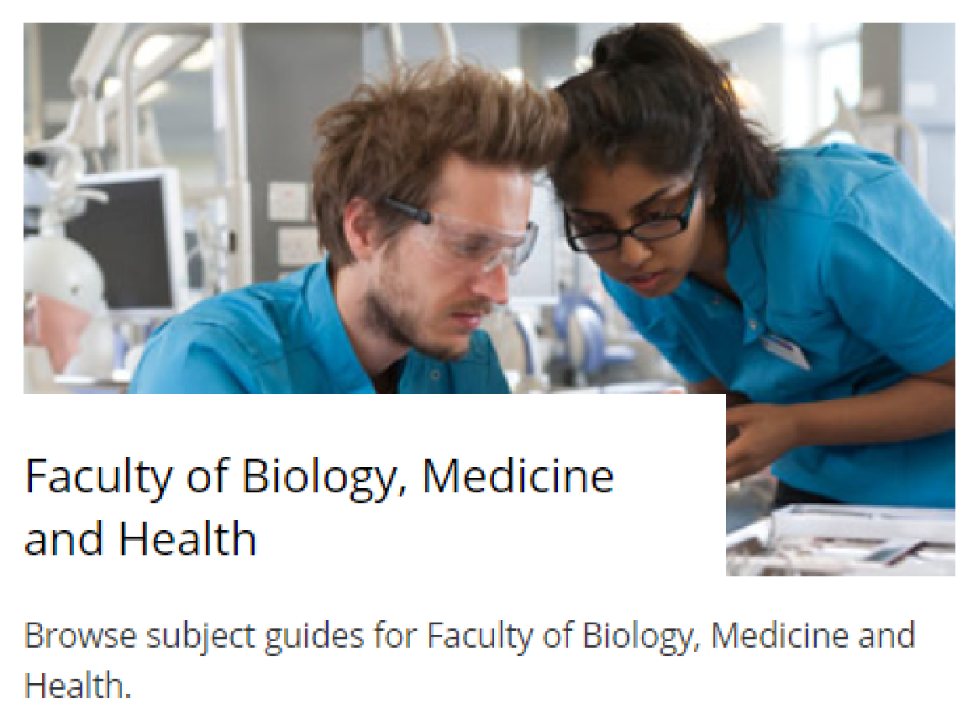
Subject guides
Notes:
Subject guides are organised by faculty and in an alphabetical list https://www.library.manchester.ac.uk/search-resources/subject-guides/

Slide 8
Your Subject Resources
The ’Subject guides’ put core resources in one central place.
Sometimes it may be useful to visit other Subject guides as well as your own if you are researching a multi-disciplinary area.
You can find the subject resources on the My Manchester pages and the Library Homepage.
Notes:
Most subject guides are laid out in the same way to make it easier for you to find your way around them

Slide 9

Human Communication subject page
Notes:
All of your core subject resources can be found on this page; https://subjects.library.manchester.ac.uk/humancommunication

Slide 10
Key databases
ComDisDome
PsycInfo
Medline
Web of Science
ASSIA
Notes:
These are the core databases used by Audiology students. ComDisDome sits on the same database platform as ASSIA and PsycInfo sits on the same platform as Medline so these databases will be similar. A platform is the host (supplier) of the database/s

Slide 11
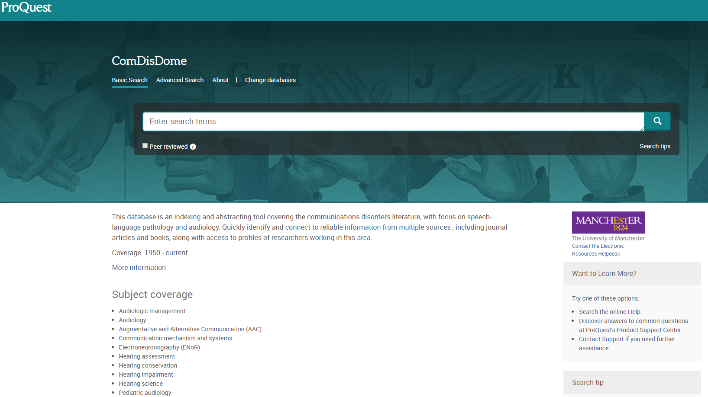
ComDisDome
Notes:
ComDisDome is the only database that is specifically for Audiology and Speech & Language students

Slide 12
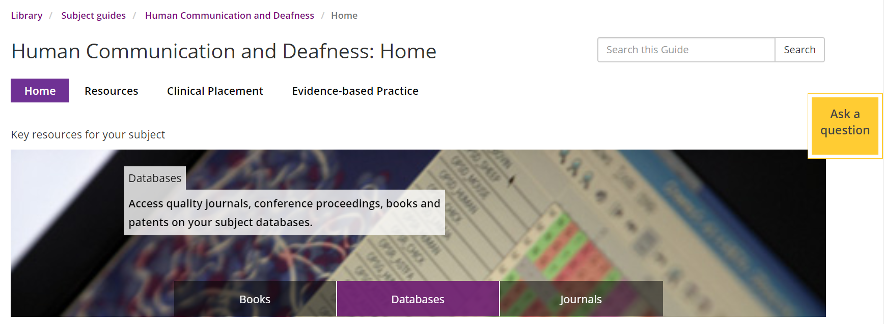
Databases
Notes:
The databases for your subject can be found on the purple Databases tab on the subject page

Slide 13
Subject Databases: Things to remember
Databases tell you what’s been published not necessarily what’s held at UML
Be mindful that different databases have different target audiences in mind
Searching different databases may reveal other terminology you may not have considered
Some databases give you direct links to their own collections of full text journals.
You need to click on the links to check other possible holdings (i.e. other electronic providers, hard copy locations etc.)
Notes:
There are a few misconceptions surrounding subject databases. A few are addressed here;
Databases are all the same.
False - Different databases may yield differing ranges of results when the same search terms are used. Databases are not all the same. Many have specific target audiences in mind.
Databases are difficult to use – they all work differently
Databases do have slightly different levels of functionality however the basic fundamentals of searching still apply to all of them. Most databases support Boolean and you can still construct searches in a similar way across most databases
Databases give you thousands of results or none at all
It is rare that a database will find no records at all. You need to experiment with different search terms and use the search tools within the databases to help you. If you have thousands of results you may have used too many search terms in your search strategy
Google and Google Scholar gives me everything I need
Google and Google Scholar are legitimate sources of information and contain many useful sources of grey literature. However these should be used in conjunction with academic databases which contain thousands of journal articles that are not found on Google or Google Scholar
One advantage of using databases is that you can save your searches on the database platforms, which enables you to rerun your searches another time. See the Advanced Searching online resources for further information.

Slide 14
Academic process
Search
Read
Reflect
Write
Notes:
Searching for literature is a key skill that contributes directly to the completion of any research project. You will be expected to document the focus of your research (your research question) and the steps you took to research this topic. Your tutor will expect to see details of your search terms and your search strategies in addition to details of the information sources (databases etc.) you have consulted.

Slide 15

Assignment title
Think about the main concepts:
Describe and explain how listening to music at excessive noise levels can damage hearing
Notes:
Suggested Study Tip:
Jot down the main components of your research area that you ARE interested in
Then jot down the topic areas you are NOT interested in.
Why should I do this?
This enables you to see more clearly what your inclusion and exclusion criteria is
Focusing the scope of your research area is important because your topic may cover a wide area. It is important that you consider related areas that you are not interested in so that you can more easily control the direction of your research

Slide 16
Before you start
Write down all the words that you can think of that relate to your topic.
Divide them into groups of words that:
you must have
you don’t mind having
you definitely do not want
Notes:
Suggested Study Tip:
Think about your research question as a whole then break it down into specific concepts or parts. Think about the search terms that relate to each concept and for each concept jot down all the terms;
You definitely want
You would consider using
You definitely do not want
Why should I do this?
Many research areas are broader and more wide-ranging than you think. You need to focus on the core areas you are interested in. Having looked at your research question as a whole you need to analyse each specific component and identify core search terms associated with each component

Slide 17

What can you see here?
CC0 Public domain: https://pixabay.com/en/love-seat-couch-sofa-pillows-1090458/
Sofa?
Couch?
Settee?
Notes:
All these terms are variations of a description for a seat – they are all correct – but not everyone will instantly think of the same description

Slide 18
Activity
Look at this research question:
Describe and explain how listening to music at excessive noise levels can damage hearing
Write down as many words you can think of that address this question
Notes:
Think of related themes that ay also be of interest and prioritise your concepts. Which are the most important? Which are of secondary importance?

Slide 19
Alternative words and synonyms
Noise
Music
Hearing loss
volume
OR
loud
OR
amplification
audio
OR
sound
OR
“heavy-metal”
hearing impairment
OR
hearing damage
OR
deaf*
Notes:
Different/similar terms can produce very different results depending on which databases you use .
The usage of “quotation marks”, truncation* joinedwords and hyphenated –words can influence the range of results

Slide 20
Organising and Combining search terms
amplification
OR
volume
OR
loud
music
OR
sound
OR
audio
AND
hearing loss
OR
deaf*
Notes:
These three little words – AND, OR, NOT are quite useful… and it is important you know how they work
OR allows you to group similar concept terms together
AND allows you to join different concept terms together

Slide 21
Search tools
Search Operators: AND OR NOT
AND narrows a search;
hearing AND noise
OR broadens a search;
hearing impaired or deafened
NOT excludes a search term;
hearing aids NOT aids
Notes:
When using OR as a search operator, it should be used between terms that have very little distinction in definition. OR expands a search…

Slide 22
Search tools
Truncation: Deaf*
= Deaf
Deafened
Deafness
Some databases support “phrase searching” e.g. “hearing aids”
Notes:
Truncation expands the root* of a word. Be careful where you place it for example dea* would include, deal, death, dead etc.

Slide 23

Planning your search
http://cdn.morguefile.com/imageData/public/files/m/Melodi2/12/l/1385890930z9igj.jpg
Notes:
We do not expect you to know everything about searching, A lot of trial and error is involved. We have a collection of resources that you may find useful on our My Learning Essentials Pages; https://www.library.manchester.ac.uk/using-the-library/students/training-and-skills-support/my-learning-essentials/online-resources/

Slide 24
Activity
Think back to this research question:
Describe and explain how listening to music at excessive noise levels can damage hearing
Choose one database and search for articles to help you address the question
Notes:
Start by typing in one or two similar concept words (hearing impairment OR deafness) and see how many results you get. Then do the same with the second concept (noise).
Then join these together - hearing impairment OR deafness AND noise

Slide 25

Searching for information
http://cdn.morguefile.com/imageData/public/files/m/Melodi2/12/l/1385890930z9igj.jpg
Notes:
We do not expect you to know everything about searching, You may need to look in several databases depending on your research area. If the first database does not bring you many results experiment with your keywords or try another database.
We have a collection of resources that you may find useful on our My Learning Essentials Pages; https://www.library.manchester.ac.uk/using-the-library/students/training-and-skills-support/my-learning-essentials/online-resources/

Slide 26
Evaluating Information
What type of resource is it?
What is the content? Is it relevant to my topic?
Why was it produced? Is it objective?
When was it produced?
How was this information produced? Does the author include references?
How was the data collected?
Where was it published?
Who wrote it?
Who is the target audience?
Notes:
When you have found some journal articles on the databases you need to assess their relevance to your subject. You may wish to use a simple checklist like the one in this slide.
It is important that you adopt a critical approach when you are reading. – What do you want to find out about for your research? What pieces of information are present in the articles you are reading? Are there areas of research you need more information on?
The databases usually contain peer reviewed articles so the standard of the research has had to meet a set criterial to be included in the first place. However if you have used other sources – such as Google – you will need to be a little more diligent in checking its validity.

Slide 27

Evaluating information
Notes:
We do not expect you to know everything about evaluating your sources.
We have a collection of resources that you may find useful on our My Learning Essentials Pages; https://www.library.manchester.ac.uk/using-the-library/students/training-and-skills-support/my-learning-essentials/online-resources/

Slide 28
Using Library resources
Further Support
Notes:
We are aware that the Covid-19 pandemic may have an impact on accessing support however there are lots of online channels you can use to contact us. We are happy to arrange virtual face-to-face meetings with you at a mutually convenient time

Slide 29

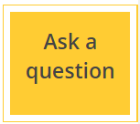

Online help
Library Chat
Available on CINAHL and Ovid databases
Available on the library subject guides
Notes:
The Ask A Librarian tools allow you to send us a copy of your searches. This is available in the Ovid and Ebsco database platforms
Library Chat is monitored during core hours and over the weekends. However you may not get an immediate response to your question. We recommend that you use the Ask A Question links for searching enquiries because these go straight to the Library’s Teaching and Learning team.

Slide 30
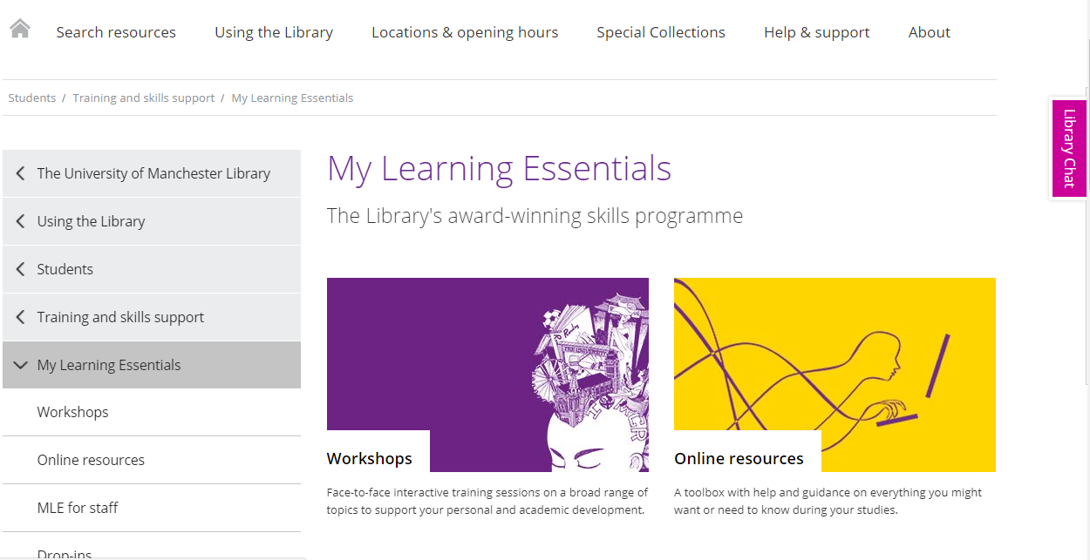
My Learning Essentials
Notes:
The My Learning Essentials online resources also contain information on developing academic skills. Please note due to the current Covid-19 pandemic most workshops are suspended although online help is still available ; https://www.library.manchester.ac.uk/using-the-library/students/training-and-skills-support/my-learning-essentials/

Slide 31
Online resources – Getting Started
Human Commncation & Deafness Subject Guide
Finding the good stuff
Knowing where to look: introducing your search toolkit
Planning ahead: making your search work
Notes:
These are some of the resources you can find on the Specialist Library Support pages; https://www.library.manchester.ac.uk/using-the-library/specialist-library-support/

Slide 32
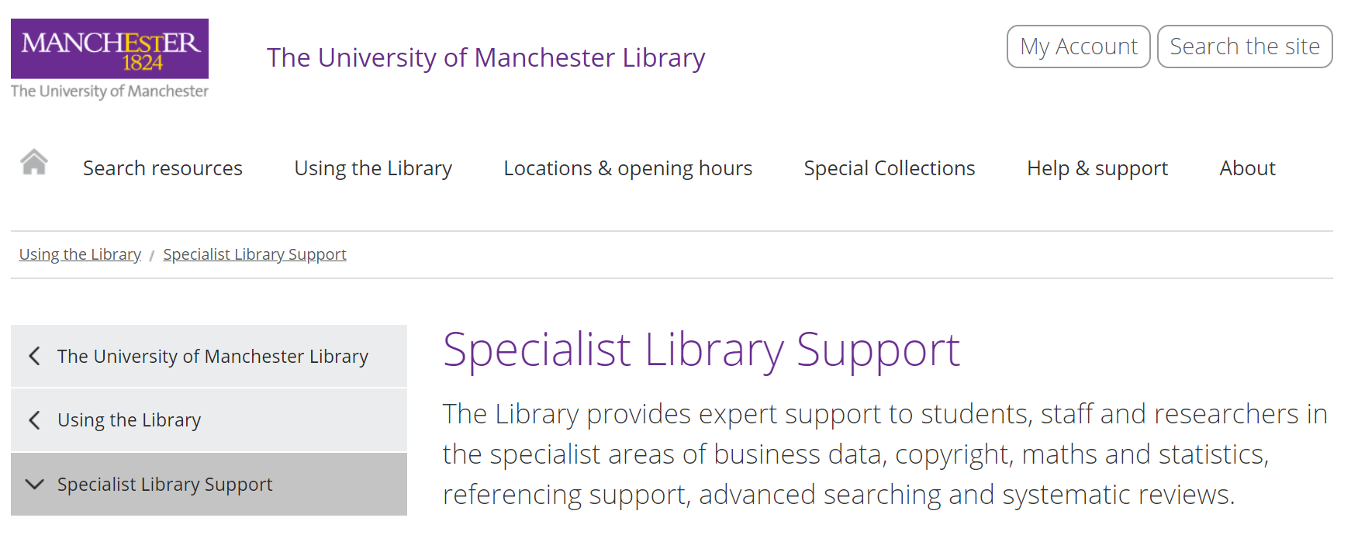
Specialist Library Support
Notes:
The Specialist Library Support team deals with searching, referencing, copyright and business data enquiries;
https://www.library.manchester.ac.uk/using-the-library/specialist-library-support/

Slide 33
Online resources – Searching Databases
Replicating searches in different Health Science database platforms
Using Search Operators in you search
Making use of MeSH and Suggested Subject Terms
Critical appraisal for medical and health sciences
Notes:
These are some of the resources you can find on the Specialist Library Support pages; https://www.library.manchester.ac.uk/using-the-library/specialist-library-support/

Slide 34
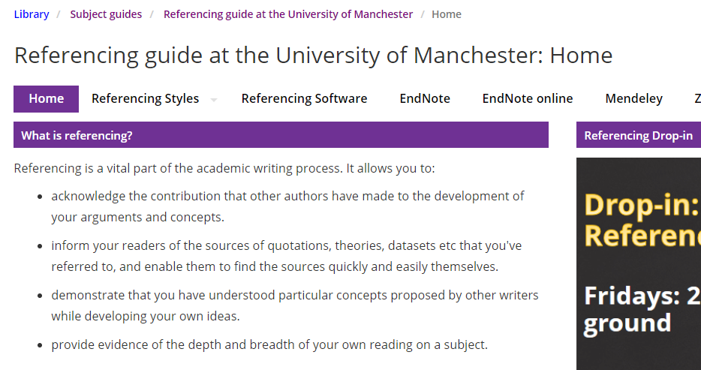
Referencing Support
Notes:
There are also some additional guidance pages on key areas such as referencing. You may choose to use referencing software to help you. The software has a dual role because it enables you to store all your references in one central place and import the references directly into your documents in the correct citation style required by your school.

Slide 35
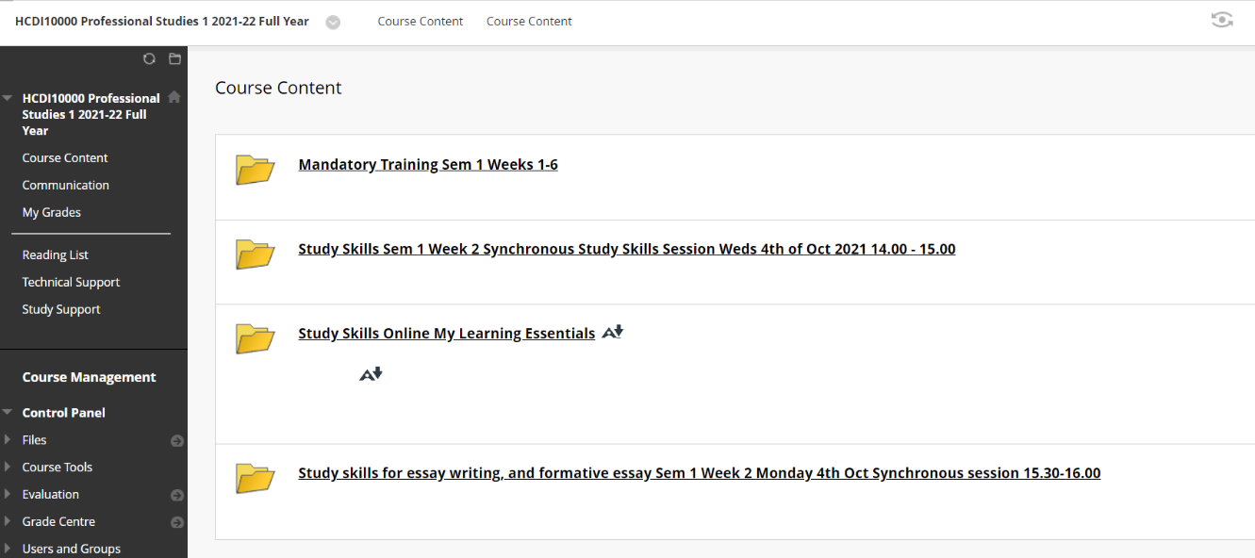
MLE resources on blackboard
Notes:
There are many resources to help you in your Blackboard pages too

Slide 36
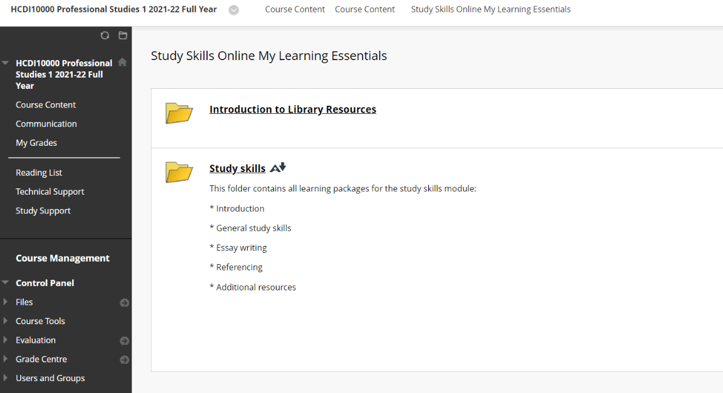
MLE resources on blackboard
Notes:
The resources include help with writing, searching and referencing..

Slide 37
Thank you for watching and happy researching!
uml.teachingandlearning@manchester.ac.uk

Slide 38


Do you think what you learned in this session will be useful to you in the future?
Yes
No

