Slide 1
GEOG60662 Preparing for your dissertation

Slide 2
Coverage
Searching for literature
How to engage critically with literature
Annotated bibliographies
How to get further help

Slide 3
Write a dissertation to demonstrate:
Knowledge and understanding of a topic
Organise and present your argument
Research a topic
Engage critically with literature
Show that you have an understanding of the topic in question, and are not just presenting everything you know about a topic
Searching for literature
Demonstrate you have researched the question adequately, using good quality sources and referencing them well
Referencing
Make sure that your argument is communicated to the reader in the clearest way possible.

Slide 4
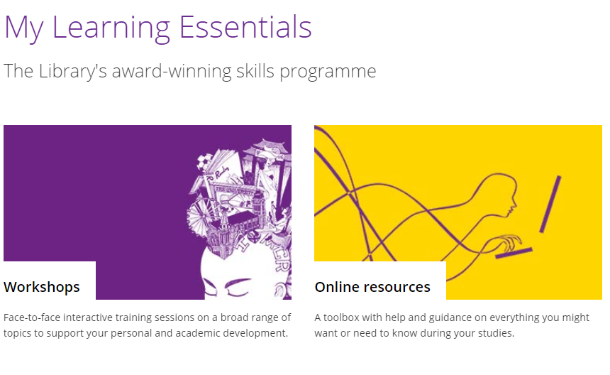
Notes:
You will find support for your academic skills development in the Libraries My Learning Essentials pages – there are online resources that cover the topics from todays session and they will be embedded in your BB space.

Slide 5
Searching for literature

Slide 6
Annotated bibliography
A Critical Annotated Bibliography is a selected list of research sources that includes concise description / summary of the source, and critical analysis / evaluation of each source. It should describe the field of research on a topic and should therefore include sources that reflect the range of approaches to the subject. The main focus is not simply to list as many sources as possible but to demonstrate an understanding of these sources.
Notes:
Being critical in an academic sense is often confused with criticism. Criticism is the act of judging something, or reacting to it negatively. You might criticise someone’s idea by sending them an ‘um, DUH’ meme like the one pictured. This is not the same as using critical thinking/writing/reading skills.
Being critical in your literature review doesn’t necessarily mean pulling literature to pieces, you can demonstrate being critical in a number of ways.
When academics talk about “being critical” or “critical thinking”, they are talking about an approach you take to everything you do. It is associated with mainly with questioning things and using these questions to develop your own argument.

Slide 7
Dissertation topic example
Aim: To assess the potential of remote sensing as a tool for monitoring peatland vegetation change
RQ 1 How are the spectral characteristics of Sphagnum influenced by changes in soil moisture?
RQ 2 How can spectral indices be used to elucidate variations in near-surface wetness from the spectral reflectance properties of Sphagnum moss?
RQ 3 What is the distribution of Sphagnum, as mapped from airborne imagery?

Slide 8
Topic title
To assess the potential of remote sensing as a tool for monitoring peatland vegetation change

Slide 9
Activity 1. Map your keywords
Work in groups of 3-4
What keywords and phrases would enable you to find relevant evidence for the suggested title.
One person in the group records all the search terms that you can all think of using Menti
www.menti.com – code:3828 6363

Slide 10
Seek out key concepts…
To assess the potential of remote sensing as a tool for monitoring peatland vegetation change
Notes:
Look at some key concepts within the title

Slide 11
What other keywords could you use?
peatlands; satellites; remote sensing; sphagnum; hydrology; vegetation cover; spectral analysis; image analysis; environmental management; environmental monitoring; infrared rays; satellite communications; spectrophotometry, infrared; water movements; wetlands; moisture stress index

Slide 12
Search Strings can expand/ refine/ exclude
(spectral analysis OR image analysis)
OR expands the search
spectral analysis AND image analysis
AND narrows the search
(spectral analysis AND image analysis) NOT peatland
- NOT refines/excludes a concept (peatland)
Notes:
Begin to batch them into groups

Slide 13
Audience response – Where do you currently look for information for your coursework?
Go to www.menti.com
Notes:
Check code

Slide 14
Research tools
Library search
Subject Guides
Google
Scholar

Slide 15
Library Search
Search books, journals, database abstracts
Save items to your e-shelf
Email references to yourself and others
Export references to Endnote, Mendeley etc.
Copy a reference in your required citation style
Notes:
Some of the features of Library Search. You will find that it is a good place to start your search.

Slide 16
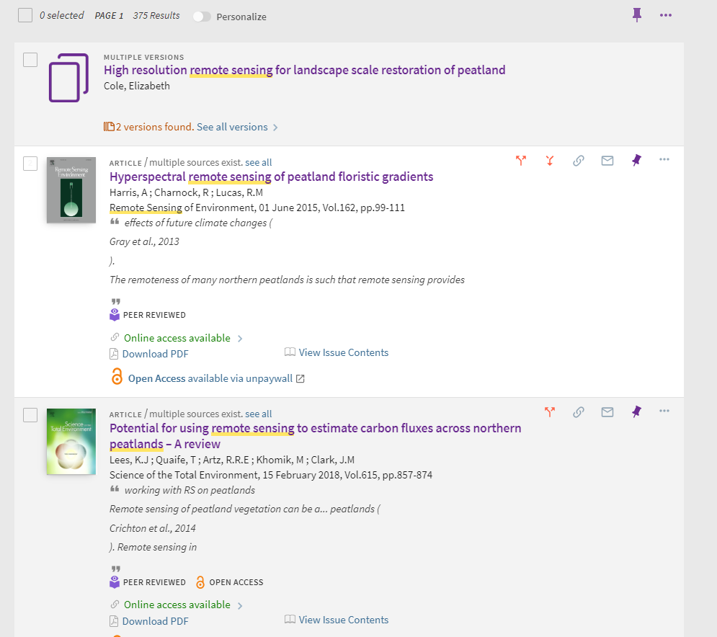
Library Search -results
Notes:
Library Search return results for both physical items within the library and electronic resources.

Slide 17
Your Subject Resources
There are a range of Subject Guides available on the Library website which put core resources in one central place
Sometimes it may be useful to visit other Subject Guides as well as your own if you are researching a multi-disciplinary area
You can find the subject resources through My Manchester and the Library homepage
Notes:
Your specific subject guide provides a curated range of databases for searching different aspects of your subject area. You might also use different subject guides – in your case, maybe the law or criminology guides.

Slide 18
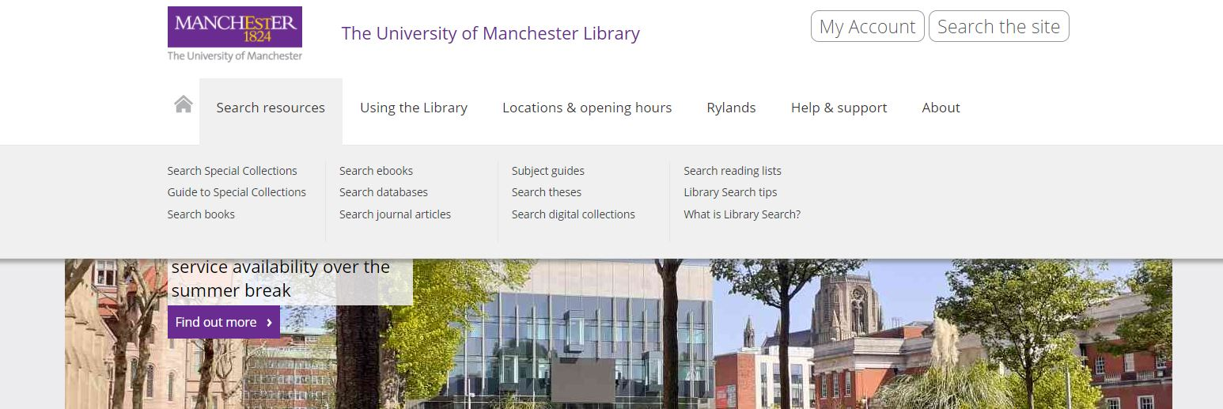
Subject Guides on the Library website
You can find the subject guides under the Search Resources tab:
Notes:
You can access the subject guides through the Library homepage: www.library.manchester.ac.uk

Slide 19
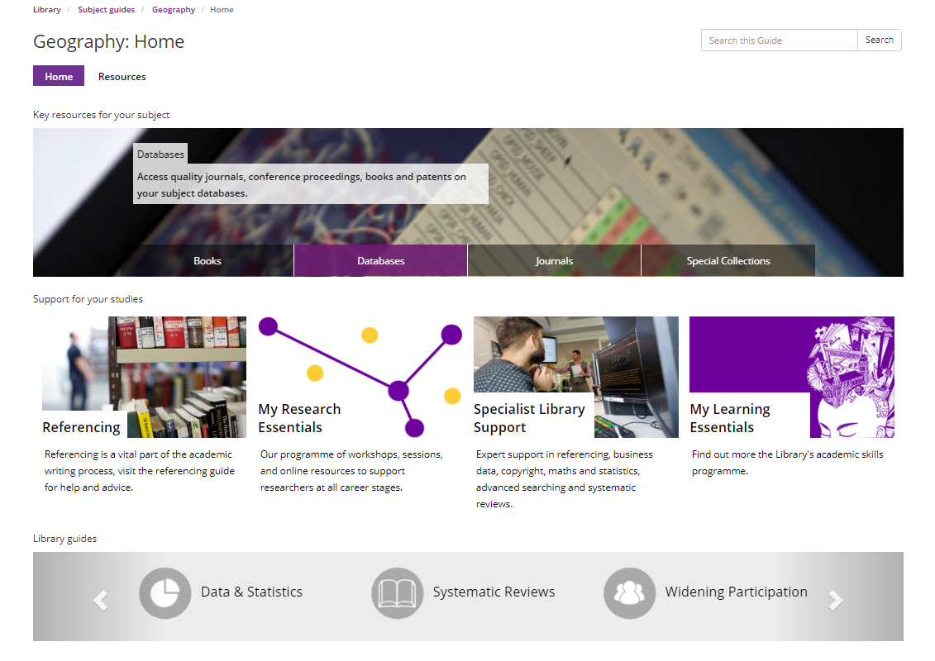
Geography Subject guide

Slide 20
Databases: Tips
The databases tell you what’s been published not necessarily what’s held at UML
Keep in mind that different databases have different target audiences in mind.
Searching different databases may reveal other terminology or search terms that you may not have considered
Some databases will give you direct links to their own collections of full text journals.
You need to click on the links to check other possible holdings (i.e. other electronic providers, hard copy locations etc.)

Slide 21
Key databases
Georef
Agricultural & Environmental Science Collection
Digimap
Web of Science/ Scopus

Slide 22
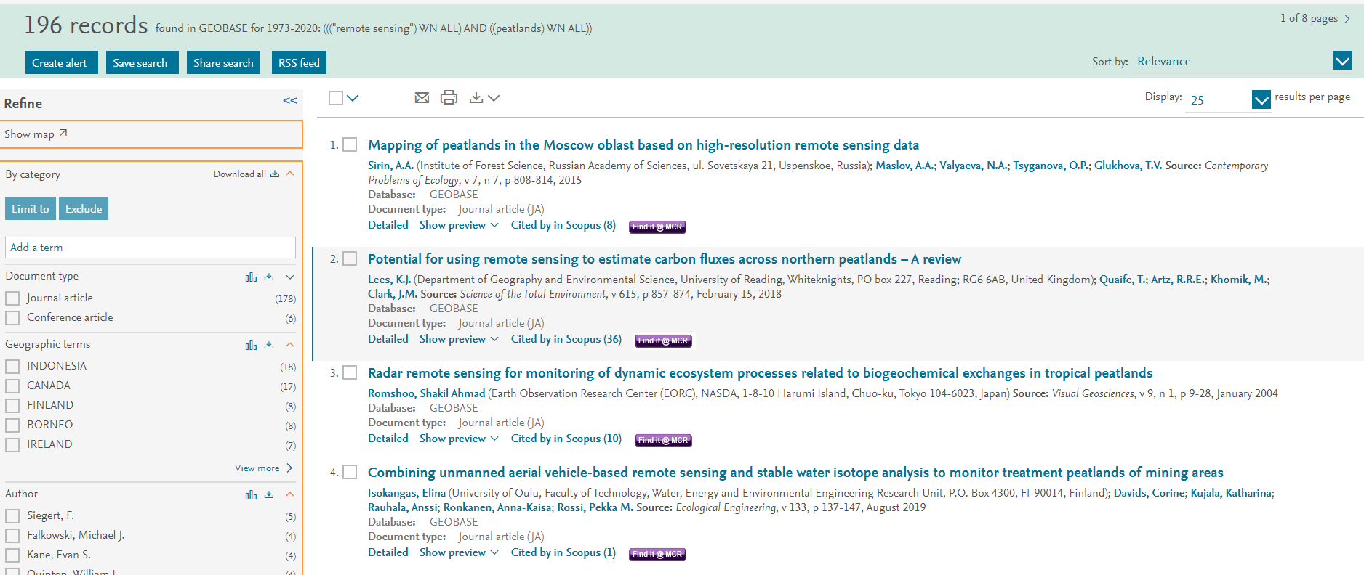
Georef

Slide 23
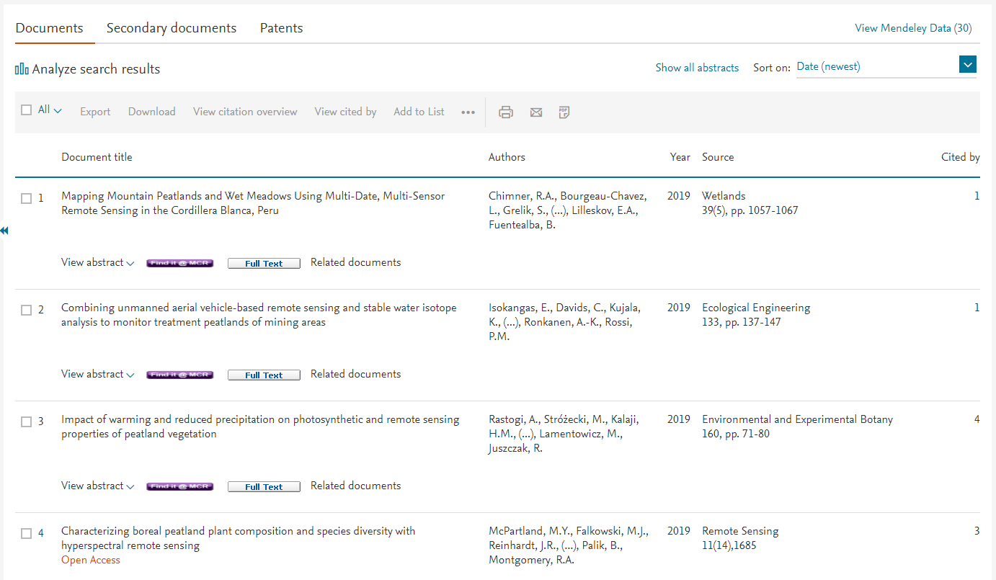
Scopus – search example (31 results)

Slide 24
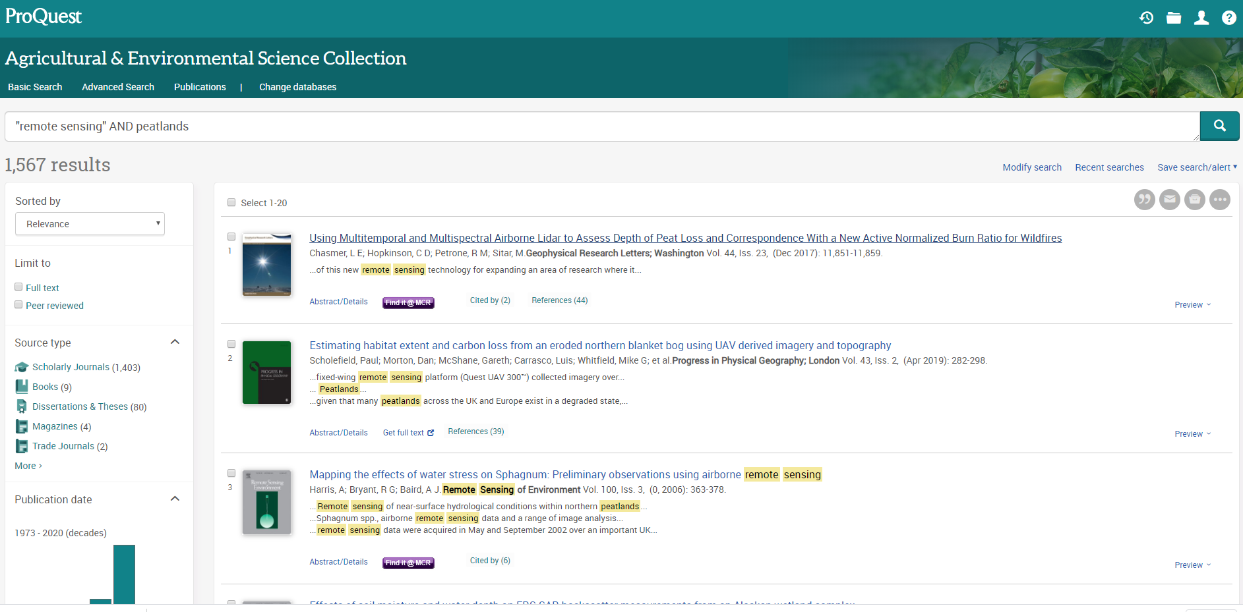
Agricultural & Environmental Science Collection
– search example

Slide 25
Audience response- Why is it important that you use these resources for your studies?
Go to www.menti.com
Notes:
Check code

Slide 26
Critical reading

Slide 27
Critical engagement with the literature
Being critical
Critical thinking
Criticality
What does being critical mean to you?
Go to www.menti.com
CC0 Public domain: https://www.goodfreephotos.com/albums/vector-images/thinking-brain-machine-vector-clipart.png
Notes:
https://www.goodfreephotos.com/albums/vector-images/thinking-brain-machine-vector-clipart.png
Being critical in an academic sense is often confused with criticism. Criticism is the act of judging something, or reacting to it negatively. You might criticise someone’s idea by sending them an ‘um, DUH’ meme like the one pictured. This is not the same as using critical thinking/writing/reading skills.
Being critical in your literature review doesn’t necessarily mean pulling literature to pieces, you can demonstrate being critical in a number of ways.
When academics talk about “being critical” or “critical thinking”, they are talking about an approach you take to everything you do. It is associated with mainly with questioning things and using these questions to develop your own argument.

Slide 28
Annotated bibliography
A Critical Annotated Bibliography is a selected list of research sources that includes concise description / summary of the source, and critical analysis / evaluation of each source. It should describe the field of research on a topic and should therefore include sources that reflect the range of approaches to the subject. The main focus is not simply to list as many sources as possible but to demonstrate an understanding of these sources.
Notes:
Being critical in an academic sense is often confused with criticism. Criticism is the act of judging something, or reacting to it negatively. You might criticise someone’s idea by sending them an ‘um, DUH’ meme like the one pictured. This is not the same as using critical thinking/writing/reading skills.
Being critical in your literature review doesn’t necessarily mean pulling literature to pieces, you can demonstrate being critical in a number of ways.
When academics talk about “being critical” or “critical thinking”, they are talking about an approach you take to everything you do. It is associated with mainly with questioning things and using these questions to develop your own argument.

Slide 29
Asking the right questions of the source material
What?
Why?
When?
How?
Where?
Who?

Slide 30
What?
What are the main arguments that are contained in the source?
What is the content of the source that is relevant to your research?
Has the information been verified in any way?

Slide 31
Why?
Why was the source written?
What was the author hoping to achieve?

Slide 32
When
When the source was published?
When was it last updated?
How often is it updated? (especially important for websites)
What is the time between any events discussed and the source’s publication?

Slide 33
How
Does the source provide references that have informed its current form?
What methodology was used?

Slide 34
Where
What is the purpose of the source and does the purpose influence the objectivity?
Where is the source published?
Was the source peer reviewed?

Slide 35
Who
Does the author have a bias?
Has the author been funded by or affiliated to an organisation?
Who is the intended audience and does this affect its relevance?

Slide 36
Activity
Try using this questioning strategy handout to help you come up with questions that you might ask of the following article.
Potential for using remote sensing to estimate carbon fluxes across northern peatlands – A review
Lees, K.J ; Quaife, T ; Artz, R.R.E ; Khomik, M ; Clark, J.M
The Science of the total environment, 2018-02-15, Vol.615, p.857-874

Slide 37
Note-taking – Cornell Notes
Key facts/ dates etc. | Main notes
 | Summary
Notes:
Elaborate on some of the notes that you made

Slide 38
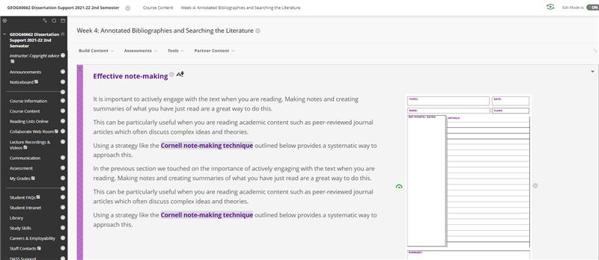
Blackboard – Study skills

Slide 39
University of Manchester phrase bank
http://www.phrasebank.manchester.ac.uk
http://commons.wikimedia.org/wiki/File:2004-02-29_Ball_point_pen_writing.jpg
Notes:
Can we just embed this in the BB space?

Slide 40
Stay in touch – we love to hear from you ​
Ask our staff anything about the library’s services and where to access support on academic skills like referencing and searching. ​
​
Available in a face to face and virtual format​
​
Library drop ins for academic support and referencing​
1-2-1 Writing Support – Royal Literary Fund Fellow​
Chat from the Library web pages​
uml.teachingandlearning@manchester.ac.uk

Slide 41
Do you think what you learned in this session will be useful to you in the future?
Yes
No

