Slide 1
Critical Analysis – A Practical Approach
Sam Aston & Charlotte Evans

Slide 2
How to join in today
Listen Discuss Write Think Reflect Read

Slide 3
Structure of the session
In today’s session, we will:
Analyse a source to identify new information.
Connect new information using a mind map.
Contextualise new information to create an original idea.

Slide 4
Critical analysis/thinking means:
Effectively questioning and evaluating what is put in front of you.
Understanding the arguments being presented and any underlying assumptions that might impact them
Assessing an argument in a wider context including other sources and your own existing understanding
Notes:
*(taken from the online resource – Thinking, Writing and Reading critically)
If you need to have visual prompts on your slides to remind you keep them in theme.
On this slide we have placed a small clock in the corner which will act as a reminder of a timed activity.

Slide 5
Examples of critical thinking in real life
Making an online purchase
Searching for products
Refining the search
Evaluating the search results
Making an informed decision

Slide 6
Critical Thinking model
Learn
Connect
Create
Notes:
These placeholder boxes are ideal for displaying 3 separate items in a sequence.
Ensure that each text box is filled in with a pale background colour (the same as the rest of the slide is fine, or a different pale colour if preferred). Right click on the text box, format shape, fill, slide background fill, close.

Slide 7
Learn
Observe what you have before you.
In particular, consider the following questions:
What do you notice or observe? If you had to describe the item, what would you say?
What is new to you?
Are there facts to note down — dates, formula, words, descriptions, events?
Is there a new “big” idea that is important to your area of study?
Notes:
When facilitating an activity, always have the activity available in writing as well as your verbal description. This will help people to check that they’re on the right track. You could choose to have the activity instructions/details on a handout, slide or both.

Slide 8
Connect
Once you learn something new, it is important to think about where the information might fit with what you already know.
What else do you know about this topic? What can you add to what you were presented?
Can you make any new connections between what is presented and what you know?
Does this result in any questions or gaps?
Notes:
When facilitating an activity, always have the activity available in writing as well as your verbal description. This will help people to check that they’re on the right track. You could choose to have the activity instructions/details on a handout, slide or both.

Slide 9
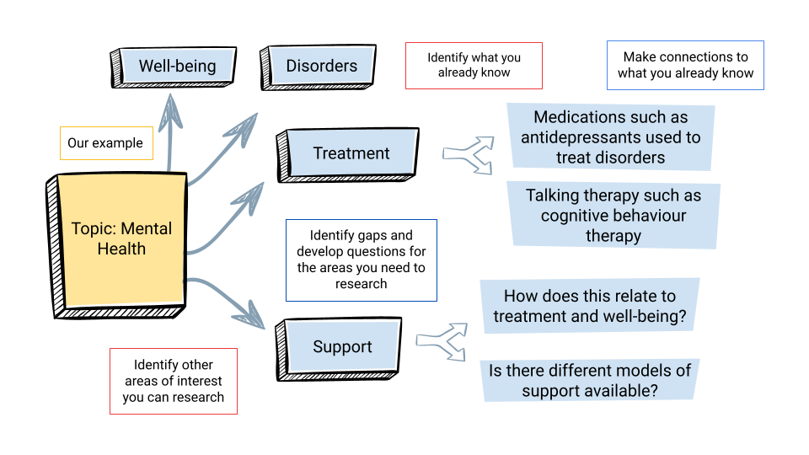
Connect using a mind map

Slide 10
Create
Start to explore original ideas which use those new connections and your existing knowledge:
Group your new connections - how does what you know now shape your understanding of the topic?
Pull out a high-level idea - how does this impact other areas in your subject? Can you add a new perspective?
Try to synthesise and blend a few connections together, can you write a short piece exploring the ideas you are putting together? If someone asked you why they were important, what would you say?
Notes:
When facilitating an activity, always have the activity available in writing as well as your verbal description. This will help people to check that they’re on the right track. You could choose to have the activity instructions/details on a handout, slide or both.

Slide 11
Let’s apply the model
We are going to look at the following article.
Macpherson, R., & Burkle, F. (2021). Humanitarian Aid Workers: The Forgotten First Responders. Prehospital and Disaster Medicine, 36(1), 111-114. doi:10.1017/S1049023X20001326
Notes:
Add link to chat https://www.cambridge.org/core/journals/prehospital-and-disaster-medicine/article/humanitarian-aid-workers-the-forgotten-first-responders/F7FA565F992B610CB51B96347205F09C

Slide 12
Recording our shared notes
We are going to use a Jamboard for you to make shared notes as we go through the model.
Go to https://jamboard.google.com/d/1W1dfpSLULXPihqPkjUFS5zS6sVTxjJvj6keNJzgbS28/edit?usp=sharing
Notes:
Add link to chat https://jamboard.google.com/d/1W1dfpSLULXPihqPkjUFS5zS6sVTxjJvj6keNJzgbS28/edit?usp=sharing

Slide 13
Learn
Take a few minutes to look at the article. Please start by noting down ANYTHING “new” you see here. Limit yourself (for now!) to some of the article that interests you.
Is there a date/concrete detail/fact you want to note?
What is the study trying to "tell" you? What does it want you to think? Feel?
What imagery or text is present? What does it tell you?
Notes:
(flick back to previous slide with image)
When facilitating an activity, always have the activity available in writing as well as your verbal description. This will help people to check that they’re on the right track. You could choose to have the activity instructions/details on a handout, slide or both.

Slide 14
Connect
Look at the notes for “learn”.
What prior understanding can you connect to that information?
What context or facts can you add to what is noted on "learn"?
What connections can you draw between elements noted on "learn"?

Slide 15
Create
Look at the work done on the Learn/Connect:
Is there an over-arching theme or topic that stands out?
Can you "fit" this new knowledge into broader context? Does it add something to your understanding of a wider topic?
Can you pull together an original opinion or analysis of what you now know?
Notes:
When facilitating an activity, always have the activity available in writing as well as your verbal description. This will help people to check that they’re on the right track. You could choose to have the activity instructions/details on a handout, slide or both.

Slide 16
Critical analysis in your practice
Working on your own, reflect on how you might incorporate this strategy into your own practice.
Do you do any of the three steps already?
How could you adapt the Learning – Connect – Create model into your reading and note-making approach?

Slide 17
In Blackboard you will find…
Content that will support you in making notes
A strategy to help your notes into writing
These slides and links to the shared notes that you have made today.

Slide 18
Stay in touch
Ask our staff anything about the library’s services and where to access support on academic skills like referencing and searching.
Available in a face to face and virtual format
Drop ins
Referencing Drop in
1-2-1 Writing Support – Royal Literary Fund Fellow
Chat from the Library web pages
uml.teachingandlearning@manchester.ac.uk

Slide 19
Do you think what you learned in this session will be useful to you in the future?
Yes
No

