Slide 1
RELT30000
Your dissertation

Slide 2
In this session you will:
Recap the purpose of a literature review;
Review strategies to find appropriate sources of information;
Discuss and apply strategies to develop your argument.

Slide 3
Example dissertation question
‘Is secularisation necessary to end religious fundamentalism?’
Notes:
We’ll be using the question ‘Is secularisation necessary to end religious fundamentalism?’ throughout today’s session.

Slide 4
Photo by Pixabay CC0
Notes:
https://www.pexels.com/photo/clouds-country-daylight-grass-371633/

Slide 5
What is the purpose of a literature review?
In groups of 3-4 discuss:
If you were marking a literature review what would you like to see?
Complete the sentence: ‘Your literature review should…’
Complete 3-4 sentences.

Slide 6
What is a literature review?
A literature review:
sets the scene and provides context
identifies significant pieces of research
guides the reader through the research landscape
identifies gaps in the research
Notes:
We’ll be using the question ‘Is secularisation necessary to end religious fundamentalism?’ throughout today’s session.

Slide 7
Components of a literature review
Themes – has the author identified key themes in the literature?
Seminal literature – a text which has had great influence in a particular field
Theory – does the author identify any?
What is known – what is known from the literature about a particular topic?
What is not known – what is not know from the literature about a particular topic?

Slide 8
Components of a literature review
Themes – has the author identified key themes in the literature?
Seminal literature – a text which has had great influence in a particular field
Theory – does the author identify any?
What is known – what is known from the literature about a particular topic?
What is not known – what is not know from the literature about a particular topic?

Slide 9
Components of a literature review
Scope of review – has the author set out what the literature review will/will not cover?
Context for review – has the author identified the context for this review?
Comparison/conflict – does the author compare and/or contrast pieces of literature?
Contribution to wider discipline – does the literature make a contribution to the wider discipline?
Summary of an individual piece of literature

Slide 10
Being critical
Identifying and grouping themes
Strengths and weaknesses of the literature
Evaluating the methodology
Comparison and conflict
Questions for further research
Contribution to broader discipline area

Slide 11
Searching for Literature
Image by Element5 Digital licensed under CC0
Notes:
3rd biggest library in the UK:
4 million books
Articles from 40,000+ journals
200+ databases (articles, reports, news, statistics)

Slide 12
Creating a strategy
WHAT am I looking for?
WHERE will I look for it?
Notes:
Spending a little extra time considering your plan of action will save you a lot of time (and effort) in the long run. As yourself – what information am I looking for? That might be a journal article or piece of primary evidence. Once we know what we want, we can think about the best place to find it.

Slide 13
WHAT
IDENTIFY the keywords
THINK OF synonyms and alternate terms
CONSIDER alternate spellings and endings
Notes:
To create a search strategy we take our research question or questions and identify the key concepts or terms that make up the question. We then think about the other ways these ideas might be described before considering alternate spellings or endings.

Slide 14
Creating a strategy
IDENTIFY the keywords
Notes:
What are the key terms or concepts within your question?

Slide 15
Creating a strategy
‘Is secularisation necessary to end religious fundamentalism?’
Notes:
Returning to our question, what are the key terms or ideas within the question?

Slide 16
Creating a strategy
‘Is secularisation necessary to end religious fundamentalism?’
Notes:
Returning to our question, what are the key terms or ideas within the question?

Slide 17
Creating a strategy
THINK OF synonyms and alternate terms
Notes:
Are there any other ways these terms or concepts might be described?

Slide 18
Creating a strategy
Secularisation
Religious fundamentalism
End?
Notes:
In pairs or small groups come up with as many alternatives for secularisation, religious fundamentalism, and what ending religious fundamentalism might mean. You might think of direct synonyms, be more specific or even more general.

Slide 19
WHERE
Library Search
Google Scholar
Subject resources
Notes:
Library Search: http://www.library.manchester.ac.uk/search-resources/
Google Scholar: https://scholar.google.co.uk/
Subject resources: http://subjects.library.manchester.ac.uk/religion/databases/

Slide 20
WHAT
Notes:
The Planning ahead resource is really useful when thinking about how you can get the best out of the search tools available to you.

Slide 21
WHAT
Notes:
It takes you from thinking about your question and the kind of information you need to find right through to reviewing and revising your search.

Slide 22
WHAT
Notes:
The know your sources resource helps you to identify and understand different sources of information.

Slide 23
WHAT
Notes:
The resource gives you key information on different types of information source and how you might make use of them in your own work.

Slide 24
Developing Your Argument
https://pixabay.com/illustrations/consulting-information-talk-2204248/

Slide 25
Writing your dissertation
Activity – what is ‘argumentative writing’?
Spend 4 minutes talking with your group
What are the features of argumentative writing?

Slide 26
What is argumentative writing?
What is an academic argument?
An academic argument is your stance, your claim, or your take on your topic.
This stance, claim, or take is your contribution to the current conversation on your topic and provides your readers with a position, perspective, and/or point of view on your topic.
An academic argument is also based in the research, what we often call "evidence-based." This means you must support your argument with findings from sources you read.
An academic argument is not....
An academic argument is not a fight, a battle, or a negative confrontation. An academic argument is also not emotional nor focused on one person's opinion
https://academicguides.waldenu.edu/writingcenter/writingprocess/arguments

Slide 27
What is argumentative writing?
An academic argument is not bickering. It is rather is more like the kind of conversation you might have if you are trying to settle something with another person, or the kind of document you might write if you are trying to convince somebody to provide you with funding, do something particular or indeed stop doing something. Another term for this kind of rhetorical and textual work could be called making a case
https://patthomson.net/2011/07/30/research-as-an-argument/

Slide 28
What is argumentative writing?
Argumentative writing includes:
a clear position / thesis statement
evidential support
analysis of the evidence

Slide 29
Thesis statements
A good thesis statement:
informs the reader of the purpose of the essay
informs the reader of the direction and scope of the essay
outlines a position (yours) which can be debated
usually ends the introduction
Notes:
What are you going to do in the essay?
How are you going to proceed and what are you going to cover?
It must be debatable otherwise it is not an argumentative essay e.g. pollution is bad for the environemnt…..

Slide 30
Thesis statements
A thesis statement:
is not the question or topic
is how you will go about answering the question or exploring the topic
is your main point, your main idea, or central message

Slide 31
Thesis statements
Activity – create a thesis statement, given the topic:
‘Is secularisation necessary to end religious fundamentalism?’
Spend 5 minutes talking with your group
What possible thesis statements relate to your topic area?
Notes:
What are you going to do in the essay?
How are you going to proceed and what are you going to cover?
It must be debatable otherwise it is not an argumentative essay e.g. pollution is bad for the environemnt…..

Slide 32
Possible Thesis Statements
Secularisation is necessary
Secularisation is not necessary
Secularisation on its own cannot end religious fundamentalism

Slide 33
Structuring an argument
Introduction
State Argument
Body text
Build Argument
Conclusion
Summarise Argument

Slide 34
Activity – Dissertation Exemplar
Read the introduction.
Can you identify the author’s thesis statement?
Have they explained how they will develop this argument?
Notes:
When facilitating an activity, always have the activity available in writing as well as your verbal description. This will help people to check that they’re on the right track. You could choose to have the activity instructions/details on a handout, slide or both.

Slide 35
Activity – Dissertation Exemplar
Look over the contents page of the dissertation.
Do you think this looks like an appropriate structure?
How does the overall structure help build the author’s argument?
Would you do anything different with your own structure?
Notes:
When facilitating an activity, always have the activity available in writing as well as your verbal description. This will help people to check that they’re on the right track. You could choose to have the activity instructions/details on a handout, slide or both.

Slide 36
Structuring an argument
Introduction
State Argument
Body text
Build Argument
Conclusion
Summarise Argument

Slide 37
Activity: Using evidence to build an argument
Step 1: Read the piece of evidence in the ‘It Says’ section.
AND SO
IT SAYS
Step 2: Write down what you think of this evidence in the ‘I Say’ section
I SAY
Step 3: Write how this helps build the argument for your chosen thesis statement in the ‘And So’ section.
Notes:
This slides can be used for a process or step by step guidelines.

Slide 38
Activity – The Toulmin Method
Use your own dissertation question / topic (or the exemplar question).
Complete the different sections of the Toulmin Method for argumentative writing handbout.
You may not have all the answers to these questions yet, but it is important that you start to think about these.
Notes:
What are they trying to say or prove
How are they supporting their statement – with evidence or opinion?
How does the writer ensure that the evidence they provide links to what they are trying to say?

Slide 39
Building an Argument
The Toulmin Method:
Thesis statement: what is the authors’ position?
Evidence: what evidence is used to support the position?
Analysis: how do the authors link the evidence to their position?
Toulmin, Stephen. The Uses of Argument. Second ed. 2003.
Notes:
What are they trying to say or prove
How are they supporting their statement – with evidence or opinion?
How does the writer ensure that the evidence they provide links to what they are trying to say?

Slide 40
Developing your argument
The Toulmin Method:
Follow up: what additional reasoning have the authors provided to support their analysis?
Counterclaim: a claim that negates or disagrees with the authors’ position.
Rebuttal: evidence that negates or disagrees with the counterclaim.
Notes:
Is there any additional reasoning the writer has used around their analysis
Are there any counterclaims that the author has used against their own position?
What evidence is then provided that disputes the counterclaim?

Slide 41
Developing your argument
Structuring your argument:
One idea per paragraph
Evidence followed by analysis
Linking to thesis statement
Notes:
Is there any additional reasoning the writer has used around their analysis
Are there any counterclaims that the author has used against their own position?
What evidence is then provided that disputes the counterclaim?

Slide 42
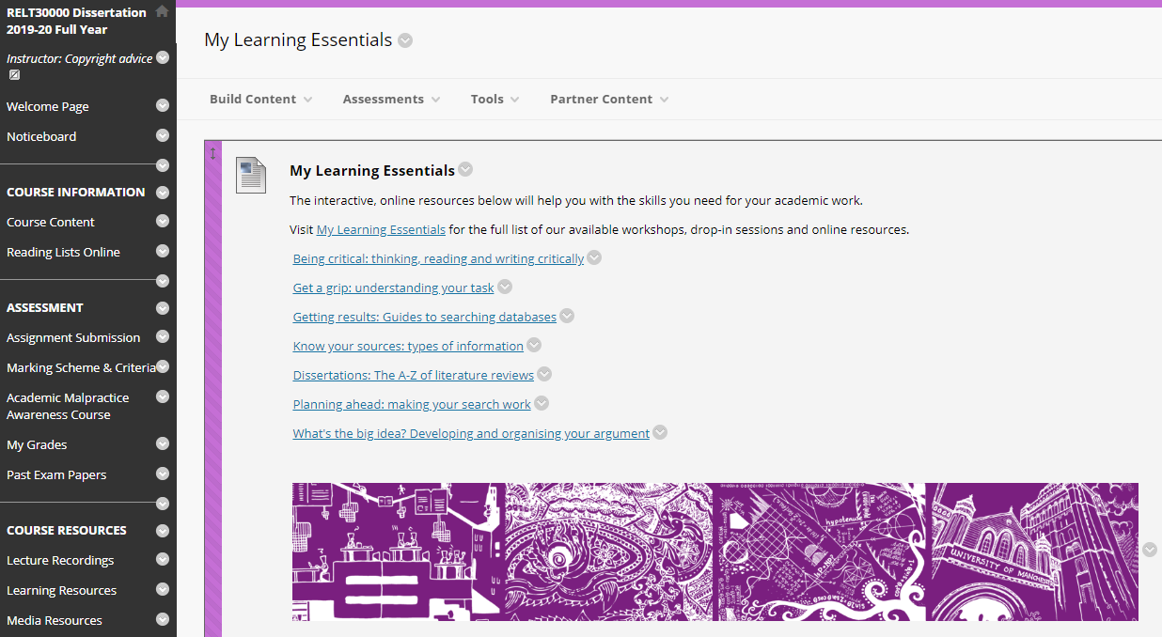
Blackboard resources

Slide 43
Help and support
Library Website www.manchester.ac.uk/library
Library Chat 9am to 5pm, Monday to Friday
Email us uml.teachingandlearning@manchester.ac.uk
Notes:
There are a number of ways to seek support after the session so please get in touch

Slide 44
Do you think what you learned in this session will be useful to you in the future?
Yes
No

