Slide 1
NURS70011
Introducing Health Sciences Databases for your research
Notes:
Searching for literature is a key skill that contributes directly to the completion of any research project. You will be expected to document the focus of your research (your research question) and the steps you took to research this topic. Your tutors will expect to see details of your search terms and your search strategies in addition to details of the information sources (databases etc.) you have consulted.
Beginning a research project can appear to be a daunting process, however remember – you have succeeded in researching for your essays in your previous degrees: The only difference is that the documentation of your research methodology requires a little more analytical thinking.

Slide 2




Session Outline
Formulate your research question and construct a search
Utilise advanced techniques such as Boolean and MeSH
Replicate searches across different databases
Organise references and document a search
Notes:
This resource revisits some of the searching skills you may already have been practising. It also encourages you to think outside the realms of Nursing and consider the possibilities that other related subject disciplines might have an interest in your research topic.
This resource also links you to other resources that demonstrate how searches could be replicated when using different subject resources.

Slide 3

Search strategy
Notes:
When you begin your research, think carefully about the topic areas you are interested in. Think about how broad or narrow these research areas may be. Are you researching one or several population groups? Could your research be of interest to other subject disciplines?
Start with the bigger picture
What do you know about your topic
What do you need to know
How will you bridge the gap?
You need to have a rough idea of your goal even if your route switches a little
You need to avoid ending up in a different destination because this wastes time

Slide 4
Before you start
Write down all the words that you can think of that relate to your topic.
Divide them into groups of words that:
you must have
you don’t mind having
you definitely do not want
Notes:
Suggested Study Tip:
Jot down the main components of your research area that you ARE interested in
Then jot down the topic areas you are NOT interested in.
Why should I do this?
This enables you to see more clearly what your inclusion and exclusion criteria is
Focusing the scope of your research area is important because your topic may cover a wide area. It is important that you consider related areas that you are not interested in so that you can more easily control the direction of your research
If you have not yet decided upon your dissertation topic, use this example question below to practice your research skills;
“How do caregivers providing end-of-life care experience grief and loss?”
Suggested Study Tip:
Think about your research question as a whole then break it down into specific concepts or parts. Think about the search terms that relate to each concept and for each concept jot down all the terms;
You definitely want
You would consider using
You definitely do not want
Why should I do this?
Many research areas are broader and more wide-ranging than you think. You need to focus on the core areas you are interested in. Having looked at your research question as a whole you need to analyse each specific component and identify core search terms associated with each component

Slide 5
Activity
Look at this research question:
“How do caregivers providing end-of-life care experience grief and loss?”
How many related words can
you find?
Notes:
For example, think about this sample research question. This is a very broad research area;
Suggested Study Tip:
When approaching your topic, consider the research questions from different angles and viewpoints;
Points to think about
What is of interest to you, and how you may approach it.
Then think how this topic may interest others and how they may approach it
Why should I do this?
Sometimes it is easy to become engrossed in a research interest from your own point of view. By looking at it from other perspectives you could find other resources that you may not have previously considered

Slide 6

Key concepts
How do caregivers
providing end-of-life care
experience grief and loss?
Notes:
Constructing a search
Why are different search terms important?
Think about the different contexts and settings the research question could focus on..
“How do caregivers providing end-of-life care experience grief and loss?”
If you look at the above example research question think how general or specific it is. - Actually, the above example research question is not very specific at all!
Who do you think of as a caregiver?
Look at the list below – Would you be interested in all of these groups?
Are some groups more important than others?
Are there more caregiver groups that are not included on this list?
Care-givers?
Medical practitioner?
Healthcare assistant?
Family?
Friend?
Suggested Study Tip:
If you have several descriptors for population groups do not search too many at one time – analyse each population group separately in relation to other concepts
For example, you could try this search;
Medical OR health care practitioner AND grief
Then you could try this search;
Family members AND grief
Why should I do this?
The two sets of results may be quite varied because the experiences of different population groups may be slightly different

Slide 7

What can you see here?
CC0 Public domain: https://pixabay.com/en/love-seat-couch-sofa-pillows-1090458/
Sofa?
Couch?
Settee?
Notes:
There is often more than one term to describe an event or object…
What other terms could be used to describe end-of-life?
End-of-life care
OR
palliative care
OR
death
OR
dying
OR
terminal care
Similar terms can be joined by the Boolean search operator OR
OR will expand the number of search results
When using OR as a search operator, it should be used between terms that have very little distinction in definition
more than one term to describe an event or object…

Slide 8
Concept breakdown
Care-givers
End-of-life care
Grief
Medical practitioner
Healthcare assistant
family
friend
palliative care
death
dying
terminal care
loss
bereavement
mourning
Emotion
Notes:
The usage of “quotation marks”, truncation* joinedwords and hyphenated –words can influence the range of results

Slide 9
Planning your search
caregivers
end of life
grie*
AND
AND
To combine key concepts
Notes:
Scoping Searches
What are scoping searches?
Scoping searches allow you to explore your research area and identify areas of potential research.
For example, if you conducted a similar search to the one on the slide on Library Search, you may get hundreds or thousands of results.
From these results you could identify key themes/areas you are interested in and equally, key themes /areas you are not interested in.

Slide 10
Reviewing the research question
“ How do caregivers providing end-of-life care experience grief and loss during the covid-19 pandemic? ”
Notes:
When you have completed some scoping searches, you may wish to refine the question. For instance, if you were looking at the example question above you may modify and focus the question. You could have narrowed the research area from;
“How do caregivers providing end-of-life care experience grief and loss?”
To;
“How do caregivers providing end-of-life care experience grief and loss during the Covid-19 pandemic?”
Important
When considering the title of your research question, any changes of research areas or title amendments must be discussed with your supervisor.

Slide 11

Search Operators and truncation
And narrows
Or broadens
Not excludes
Truncation broadens
Notes:
Additional Search Tools
Search operators (Boolean) and other search tools can help you control the focus of your research. So far this post has focused on the Boolean search operators AND and OR
If a term is not required within a search the search operator, NOT, may be used to exclude a term
In some resources, truncation signs may be used to broaden a range of results without the need to type out different variants. For example, Care* would find care, carer, carers, caregivers etc.
You need to check the resource you are using to find out which truncation sign it uses

Slide 12

Search tools
MeSH (available on most Ovid databases)
Suggest Subject Terms (available on CINAHL)
Notes:
The MeSH box is usually ticked when you go on to the Ovid database. If you search more than one database at once this will not show. We do not recommend you search more then one database at a time
Don’t forget you can save your searches and Ask A Librarian for help
Suggest Subject Terms is similar to MeSH and is only available on the Cinahl database there is an Ask A Librarian function on this database too
You have your own in built MeSH – you do not have to use the tools on the databases but it is worth giving them a courtesy look
If you are unfamiliar with MeSH this booklet can help and can be found on the library’s systematic review page and your blackboard pages?
Further information about the usage of MeSH can be found on the Making use of MeSH and Suggested Subject Terms blog post

Slide 13

Think outside the box!
https://www.google.com/url?sa=i&url=https%3A%2F%2Fcommons.wikimedia.org%2Fwiki%2FFile%3AThink_Outside_the_Box_Idea_Flat_Icon_Vector.svg&psig=AOvVaw2stcOQqkCn1WWsuN2KL8mX&ust=1596628908556000&source=images&cd=vfe&ved=0CAIQjRxqFwoTCODG0rnXgesCFQAAAAAdAAAAABAD
Notes:
Suggested Study Tip:
Think outside the box!
Why should I do this?
The meanings and contexts of some search terms may change slightly depending on the environment and population groups you are researching. Therefore, a search term used in one database may yield a different range of results in a second database
Think about the research example question;
“How do caregivers providing end-of-life care experience grief and loss?”
Consider the circumstances surrounding the grief and loss. Would the experiences of grief and loss be the same for all the population groups involved in caring for the dying?
Think of the population groups of the dying
Think of the circumstances surrounding the death

Slide 14
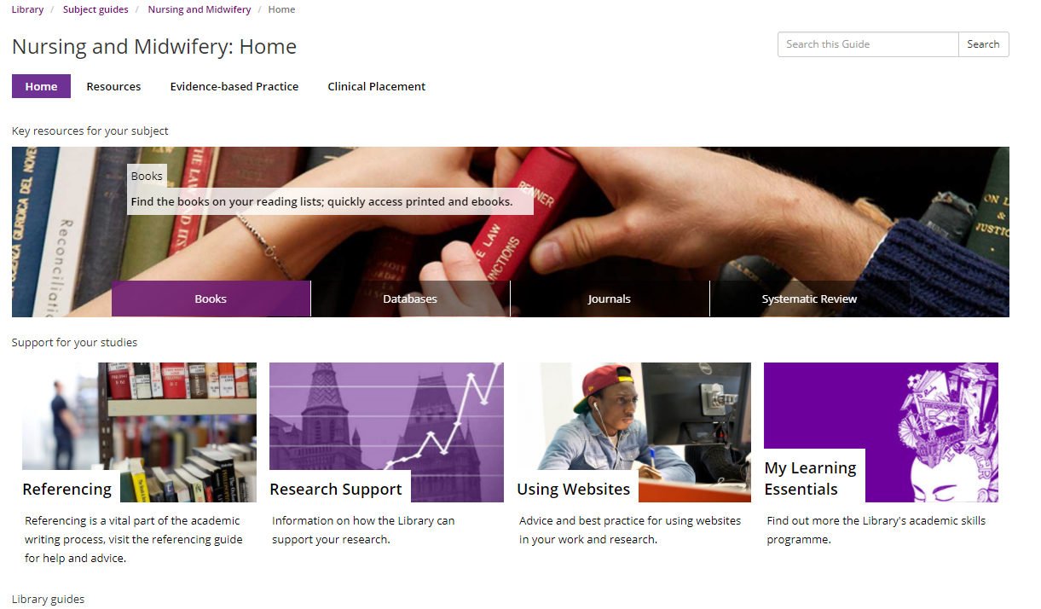
Nursing subject guide
Notes:
WHERE will you look for information?
Library Search gives an over view of broad subject areas, however the subject databases are your primary source of information.
There several databases associated with Nursing – the most common databases used are British Nursing Index, CINAHL and Medline
For this topic, you may think about using Psycinfo too

Slide 15
Activity
Think back to this research question:
“How do caregivers providing end-of-life care experience grief and loss?”
How many professions can
you think of who would be interested in this topic?
Notes:
However – if we think of the example question above - is the research question above just of interest to Nurses?
What about related professions?
Nurses
Doctors
Psychologists
Counsellors
Psychotherapists
Mental health personnel
Community leaders
Social workers
Sociologists
A new angle – How many of the other subject databases pages have you used?
Have you even used the nursing one?!

Slide 16
Possible professions
Nurses
Doctors
Psychologists
Counsellors
Psychotherapists
Mental health personnel
Community leaders
Social workers
Sociologists
Notes:
You do not have to search loads of subject pages – you just have to have an awareness that your topic may be multidisciplinary
Different databases have different target audiences in mind – they are not all the same. Terms in one databases are not necessarily given the same status or ranking in a different database

Slide 17
Databases – how many do you recognise?
Traditional Nursing Databases
Other Databases to Consider
British Nursing Index
CINAHL
Cochrane
Embase
Medline
PsycInfo
ASSIA
ComDisDome
LexisNexis
Maternity & Infant Care
Web of Science
Scopus
Social Care Online
Westlaw
Zetoc etc…..
Notes:
Replicating searches across different databases
Some topics may be well- resourced in other non-traditional nursing databases.. These are a few database used for previous nursing dissertations;
If you look on the A-Z list of databases, you will find out what subjects the above databases cover

Slide 18
Remember - Think outside the box…
“Hearing screening for New-born babies”
“A comparison of Nutrition values in foods consumed in the UK with those overseas”
Maternity & Infant Care
Medline
ComDisDome
Biological Sciences
Cochrane
Medline
Scopus
Web of Science
You may yield better results from databases which are not frequently used by your subject disciplines
Notes:
You do not have to search loads of databases or even do complicated searches – you just have to have an awareness that your topic may be multidisciplinary

Slide 19
Searching problems…
You have thousands!
You have 0
Revisit your keywords:
Could you refine them, what would help?
Are you using the right search tool?
Revisit your keywords:
Could you refine them, what would help?
Are you using the right search tool?
Notes:
There are a few misconceptions surrounding databases. A few are addressed here;
Databases are all the same.
False - Different databases may yield differing ranges of results when the same search terms are used. Databases are not all the same. Many have specific target audiences in mind.
Databases are difficult to use – they all work differently
Databases do have slightly different levels of functionality however the basic fundamentals of searching still apply to all of them. Most databases support Boolean and you can still construct searches in a similar way across most databases
Databases give you thousands of results or none at all
It is rare that a database will find no records at all. You need to experiment with different search terms and use the search tools within the databases to help you. If you have thousands of results you may have used too many search terms in your search strategy
Google and Google Scholar gives me everything I need
Google and Google Scholar are legitimate sources of information and contain many useful sources of grey literature. However these should be used in conjunction with academic databases which contain thousands of journal articles that are not found on Google or Google Scholar
One advantage of using databases is that you can save your searches on the database platforms, which enables you to rerun your searches another time. See the Advanced Searching online resources for further information.

Slide 20
Referencing Guide
Notes:
You can also export your search results into referencing software packages such as EndNote. This allows you to organise your search results and store them in one place. You can use the referencing software to remove any duplicate references. For further details on using referencing software please look at the library’s Referencing Guide

Slide 21

Documenting your search strategy
Information to include;
Source (database name)
Search terms
Inclusion/exclusion criteria
Time period covered (years)
Number of results found in each source
In your reference list you include specific journal citation details …
Notes:
Organising references and documenting a search
Organising your references and documenting your search should be simultaneously so that your research stays on track. Referencing software packages can enable you to organise your references and import them directly into your dissertation text in the citation style required by your School. For further details on using referencing software please look at the library’s Referencing Guide
HOW will you document your search strategy?
It is important to keep notes on the search process so that you know what you have searched and how you have searched. You should document the following pieces of information;
The information source (database name)
The search terms used
The inclusion/exclusion criteria
The time-period covered (years)
The number of results found in each source
Some people find search frameworks such as PICO helpful in the documentation process. However, these are not compulsory and not all research questions fit neatly into these structures. It is important to remember that search frameworks are there to help you think through your research, not to dictate the direction of your research.

Slide 22


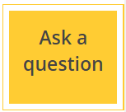
Online help
Library Chat
Available on CINAHL and Ovid databases
Available on the library subject guides
Notes:
The Ask A Librarian tools allow you to send us a copy of your searches. This is available in the Ovid and EBSCO database platforms
Library Chat is monitored during core hours and over the weekends. However you may not get an immediate response to your question. We recommend that you use the Ask A Question links for searching enquiries because these go straight to the Library’s Teaching and Learning team.

Slide 23

Specialist Library Support
Notes:
The Specialist Library Support team deals with searching, referencing, copyright and business data enquiries;
https://www.library.manchester.ac.uk/using-the-library/specialist-library-support/

Slide 24
Suggested online resources
Nursing subject guide
Finding the good stuff
Knowing where to look: introducing your search toolkit
Planning ahead: making your search work
Notes:
These are some of the resources you can find on the Specialist Library Support pages; https://www.library.manchester.ac.uk/using-the-library/specialist-library-support/

Slide 25
Suggested online resources
Replicating searches in different Health Science database platforms
Search operators: refine AND combine OR NOT?
Making use of MeSH and Suggested Subject Terms
Critical appraisal for medical and health sciences
Notes:
These are some of the resources you can find on the Specialist Library Support pages; https://www.library.manchester.ac.uk/using-the-library/specialist-library-support/

Slide 26
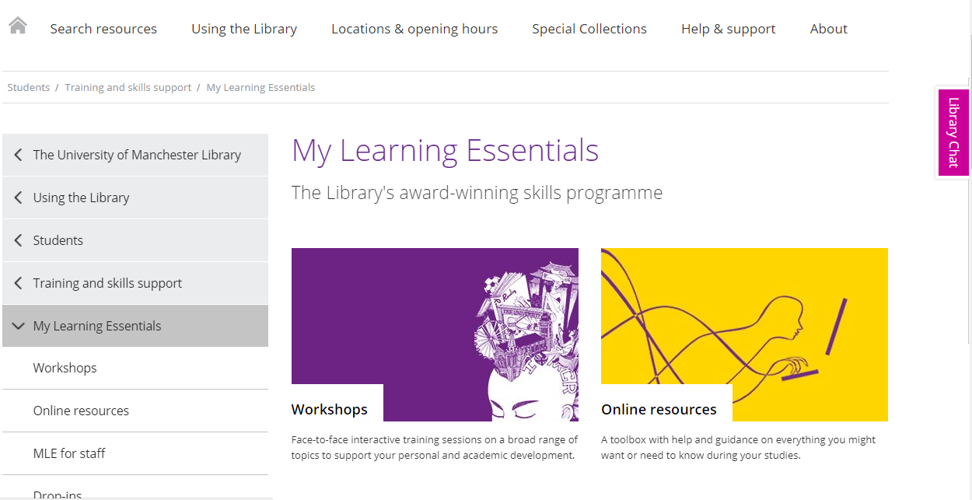
My Learning Essentials
Notes:
The My Learning Essentials online resources also contain information on developing academic skills. Please note due to the current Covid-19 pandemic some workshops are suspended although online help is still available ; https://www.library.manchester.ac.uk/using-the-library/students/training-and-skills-support/my-learning-essentials/

Slide 27
Thank you for watching and happy researching!
uml.teachingandlearning@manchester.ac.uk

Slide 28


Do you think what you learned in this session will be useful to you in the future?
YES
NO

