Slide 1
MACE:
Project Management Research Methods
Finding and using information

Slide 2
Activity
Discuss on your tables:
What have you been finding difficult when searching for literature?
Go to www.menti.com and use code: 32 94 50 to share your ideas with the group.
7 minutes

Slide 3
Session outline
Planning Your Search
Searching Strategies
My Learning Essentials
Understanding sources

Slide 4

WHAT
Am I looking for?
Notes:
Where am I going to look for these resources?
As a student at the University of Manchester you have a whole host of search resources available to you electronically, as well as use of the physical library.

Slide 5

WHAT type of sources am I looking for?
Books
Research Papers
Websites
Reports
Review Papers
Blogs
Statistics
Conference proceedings
Newspapers

Slide 6
Heading
Conference Paper
Conference Proceeding
Journal article
Usually given verbally:
- oral presentation
- poster
- table discussion.
Usually only abstract is peer-reviewed.
Written version of a conference paper.
Conference talks published together in a proceeding.
Review process not always as robust as journal articles.
Shorter than books. Written about very specific topics.
Written by experts for experts.
Peer-reviewed by experts.

Slide 7

Search resources

Slide 8
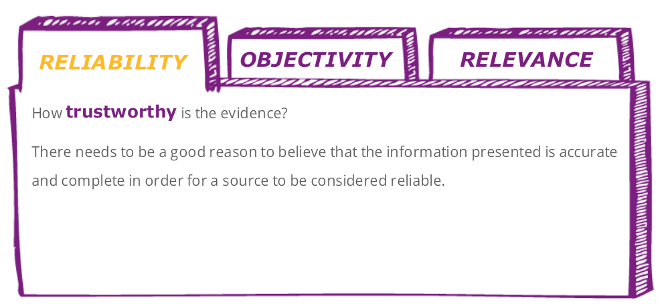
Evaluating your sources
Notes:
Where am I going to look for these resources?
As a student at the University of Manchester you have a whole host of search resources available to you electronically, as well as use of the physical library.

Slide 9
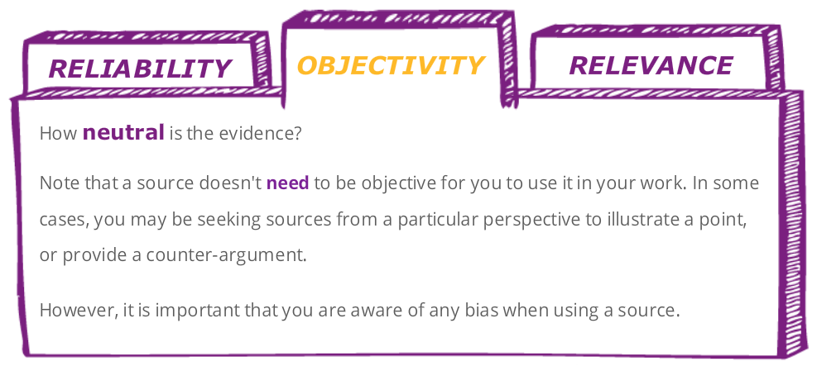
Evaluating your sources
Notes:
Where am I going to look for these resources?
As a student at the University of Manchester you have a whole host of search resources available to you electronically, as well as use of the physical library.

Slide 10
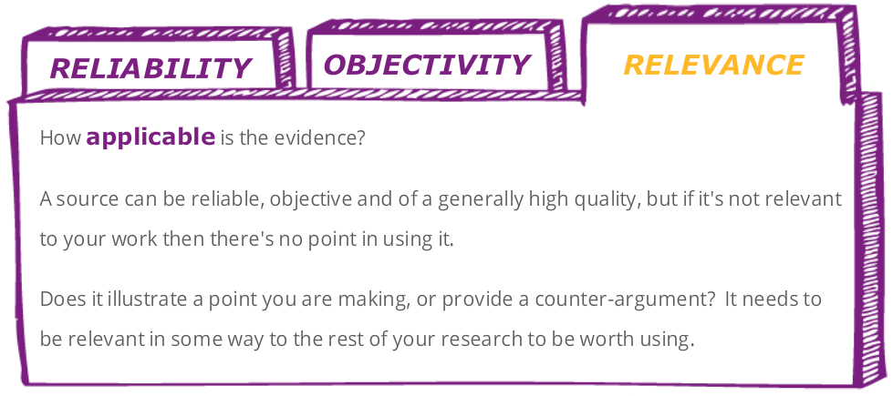
Evaluating your sources
Notes:
Where am I going to look for these resources?
As a student at the University of Manchester you have a whole host of search resources available to you electronically, as well as use of the physical library.

Slide 11
WHAT types of sources am I looking for?
  Source Quiz: go to www.menti.com
  Enter code 32 94 50

Slide 12



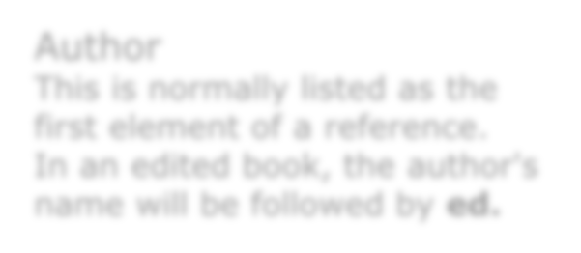
Book References
Boatright, J. (2006) Ethics and the conduct of business. 5th edn. New Jersey: Pearson Prentice Hall
Date
Title
The year the book was published.
Title and subtitles of the book. Italicised in Harvard style.
Author
Normally list as the first element of a reference. In an edited book, the author’s name will be followed by ed.
Place of Publication
City of publication and publisher.

Slide 13

Journal Article References
Snowden, D.J. and Boone, M.E. (2007) ‘A leader’s framework for decision making’, Harvard Business Review, 85(11), pp. 68-76.
Author
Date
Normally list as the first element of a reference.
Year of publication
Journal title
Name of the journal. Italicised in Harvard.
Article title
The title and subtitle.
Volume and issue number
Page numbers
Academic journals are organised by volumes and issues. The first number is the volume, the second is the issue.
Page numbers for the individual article.

Slide 14

Citing It Right

Slide 15

Planning your search
http://cdn.morguefile.com/imageData/public/files/m/Melodi2/12/l/1385890930z9igj.jpg

Slide 16
WHERE
will I look for it?
Notes:
Where am I going to look for these resources?
As a student at the University of Manchester you have a whole host of search resources available to you electronically, as well as use of the physical library.

Slide 17
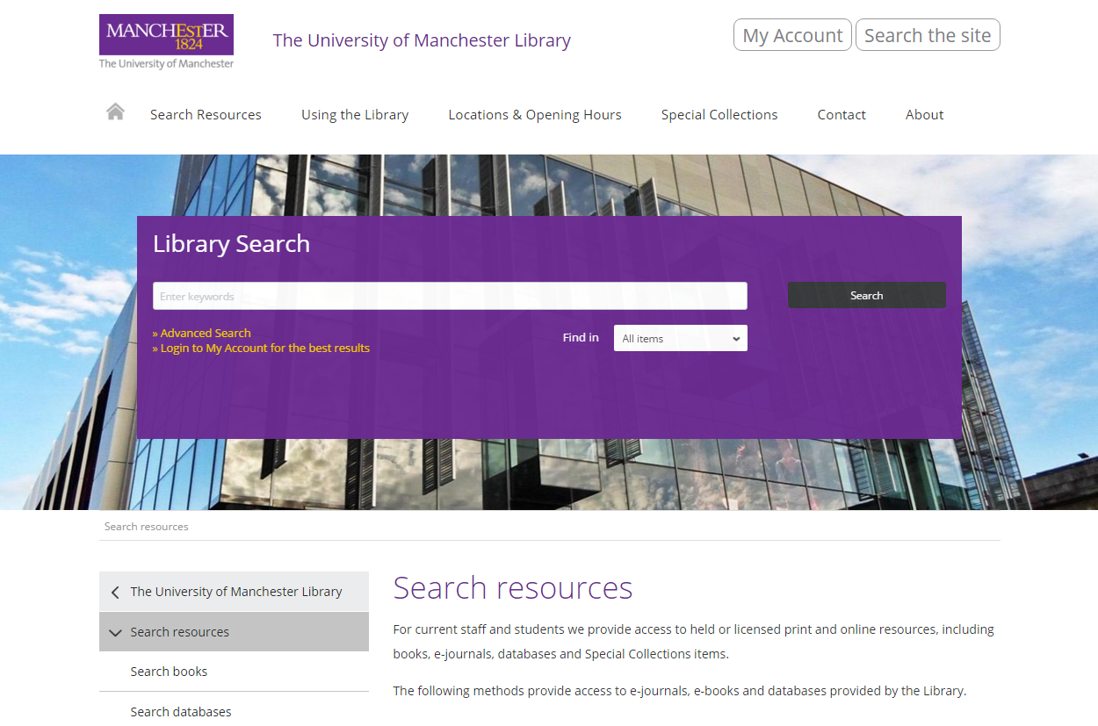
Search resources – Library Search
Notes:
Where am I going to look for these resources?
As a student at the University of Manchester you have a whole host of search resources available to you electronically, as well as use of the physical library.

Slide 18

Why use Library Search?
Fast
User friendly
Focuses on library content
Links directly to full-text (If library has access!)
You can save items to your e-bookshelf
You can search by collection or resources type
You can export references to other software
You can email references
You can view references in different citation styles
Notes:
Show of hands – who has heard of Library Search?
It can be a good tool when you are trying to get a feel for your search terms and the current work surrounding your topic.

Slide 19
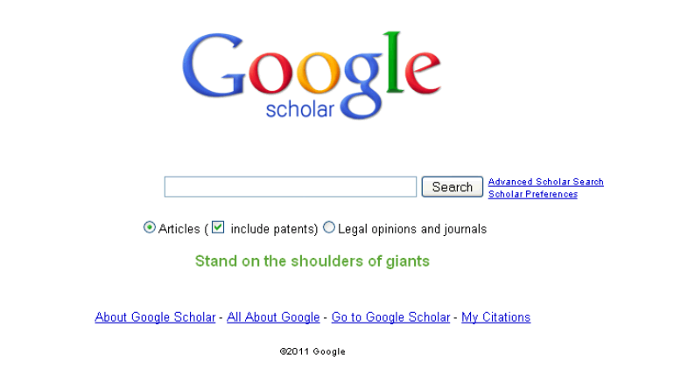
Search resources – Google Scholar
Notes:
Where am I going to look for these resources?
As a student at the University of Manchester you have a whole host of search resources available to you electronically, as well as use of the physical library.

Slide 20
Google Scholar
Fast
User friendly
Content growing exponentially
Links directly to full-text (If library has access!)
Not just English language
Searches “grey literature” not available within library databases
Notes:
Show of hands – who uses Google Scholar?
It can be a good tool when you are trying to get a feel for your search terms and the current work surrounding your topic.

Slide 21

Google Scholar
Google ranking criteria?
Search impacted by history / location
Not all journals indexed
6-12 months delay
Advanced searching options limited
Ignores other valuable sources (e.g. news, market reports, statistics)
Notes:
There are however a number of limitations. Mainly the volume of results returned and the relative lack of control you have in narrowing those results.

Slide 22
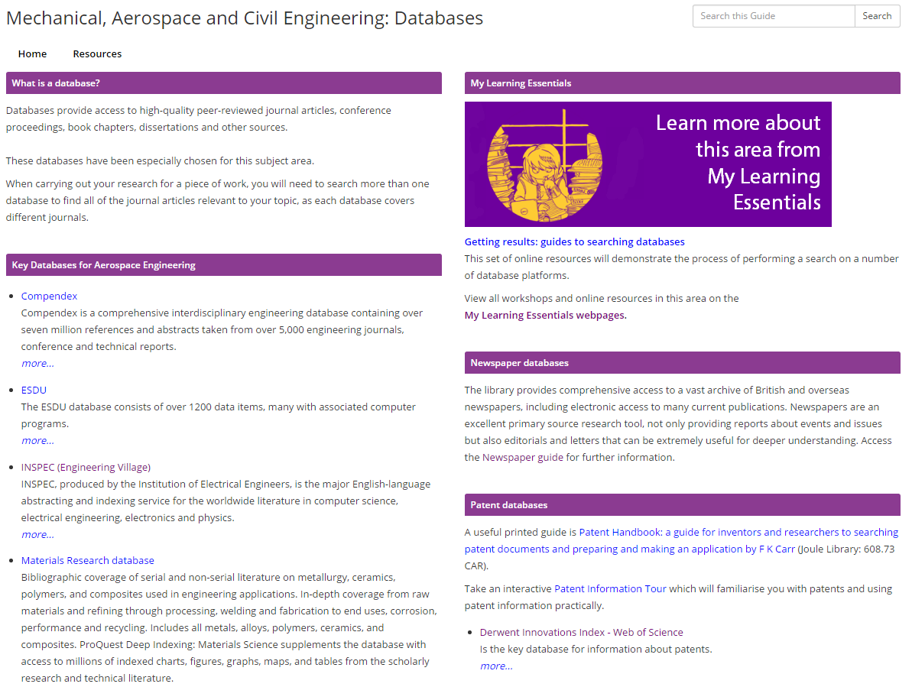
Search resources – subject databases (MACE)
Notes:
Where am I going to look for these resources?
As a student at the University of Manchester you have a whole host of search resources available to you electronically, as well as use of the physical library.

Slide 23
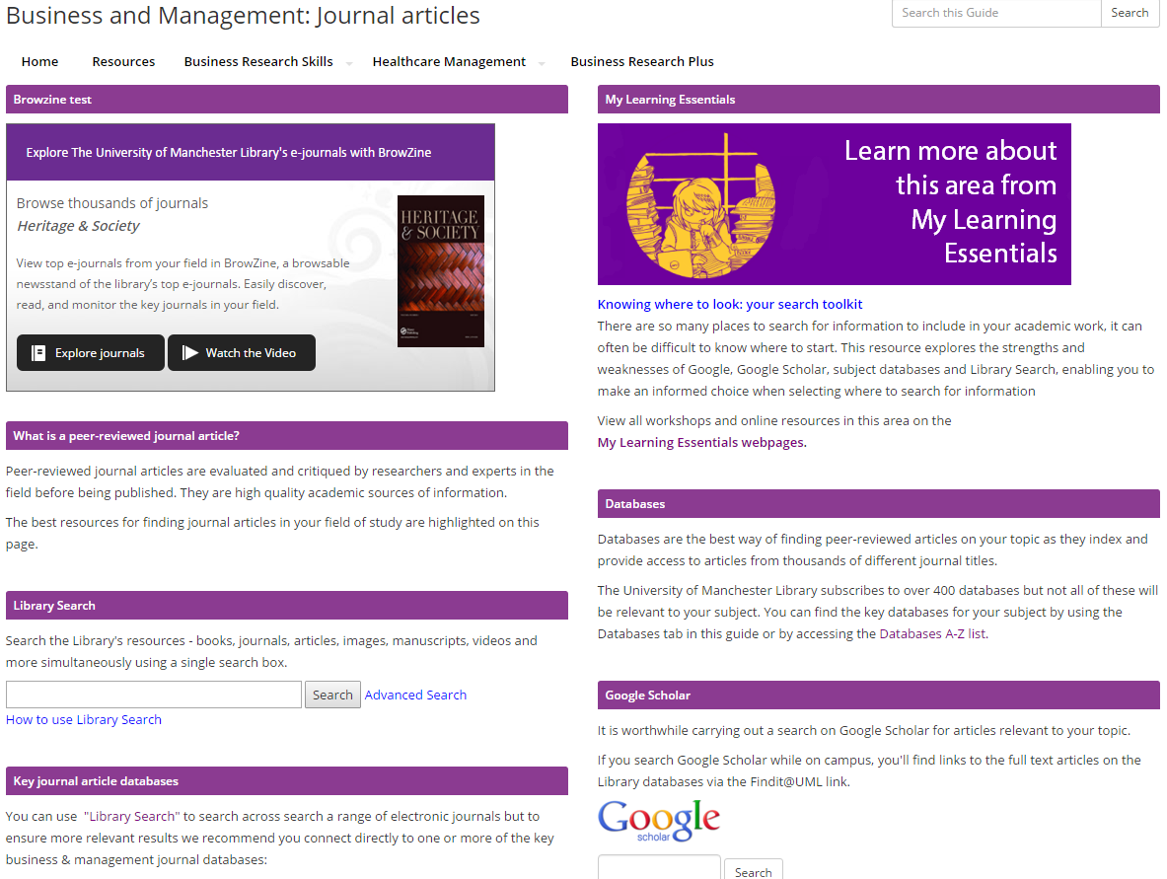
Search resources – subject databases (business)
Notes:
Where am I going to look for these resources?
As a student at the University of Manchester you have a whole host of search resources available to you electronically, as well as use of the physical library.

Slide 24
Why use Library Subject pages?
Your core resources are in one central place
Easy to use - all subject pages have the same layout
Contains links to specific subject databases
Gives links to My Learning Essentials resources
Can limit search to peer-reviewed items

Slide 25

Search resources

Slide 26
How
Will I look for it?
Notes:
Where am I going to look for these resources?
As a student at the University of Manchester you have a whole host of search resources available to you electronically, as well as use of the physical library.

Slide 27



HOW - Search Strategies.
Alternative search terms.
Boolean operators.
The citation trail.

Slide 28
Strategy 1: Alternative search terms
IDENTIFY
the keywords
THINK OF
synonyms and alternate terms
CONSIDER
alternate spellings and endings

Slide 29
Strategy 1: Alternative search terms
Does the use of a multi-disciplinary project team enhance the quality of the outcome?
Notes:
So, let’s take this example question.

Slide 30
Strategy 1: Alternative search terms
Does the use of a multi-disciplinary project team enhance the quality of the outcome?
Notes:
So, let’s take this example question.

Slide 31
Planning your search
multi-disciplinary…​ Cross-team, interdepartmental, integrative… Any subject specific meanings
Manager, management, manages
Organize, organise
IDENTIFY
the keywords
THINK OF
synonyms and alternate terms
CONSIDER
alternate spellings and endings

Slide 32
Planning your search
outcome…​
“increased efficiency”, “improved communication”, “reduced wastage”
Any subject specific meanings
IDENTIFY
the keywords
THINK OF
synonyms and alternate terms
CONSIDER
alternate spellings and endings

Slide 33
Planning your search
  Demo: applying this approach to your search
Notes:
So, let’s take this example question.

Slide 34
Planning your search
  Discuss the benefits and challenges of applying agile project management to construction projects.
Notes:
So, let’s take this example question.

Slide 35
Planning your search
  Your turn: go to www.menti.com
  Enter code 32 94 50
Notes:
So, let’s take this example question.

Slide 36
Search Strategy 2: Boolean Operators
skills
OR
abilities
OR
capabilities
OR
attributes
Project management
OR
PM
OR
Change management
OR
Process improvement
AND

Slide 37
Your search terms
First concept
Second concept
skills
OR
abilities
OR
capabilities
OR
attributes
Project management
OR
PM
OR
Change management
OR
Process improvement

Slide 38
Planning your search
  Your turn: go to www.menti.com
  Enter code 32 94 50
Notes:
So, let’s take this example question.

Slide 39
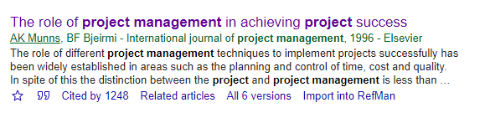

Search Strategy 3: The Citation Trail
Going Backwards
Going Forwards
Google Scholar
Reference Lists
In-Text Citations
Search for recurring authors, as well as terms
Notes:
This table could be used to compare two options i.e., fixed vs growth mindset.

Slide 40
Planning your search
  Your turn: go to www.menti.com
  Enter code 32 94 50
Notes:
So, let’s take this example question.

Slide 41



My Learning Essentials
Workshops
Drop ins
Online resources

Slide 42
Benefits of My Learning Essentials
‘…multiple users of MLE have a higher probability of graduating with a first class degree than non-users and the difference between the two groups is one which can be claimed to be statistically significant…’
(Blake, Grayson & Karamlla-Gaiballa, 2019)

Slide 43
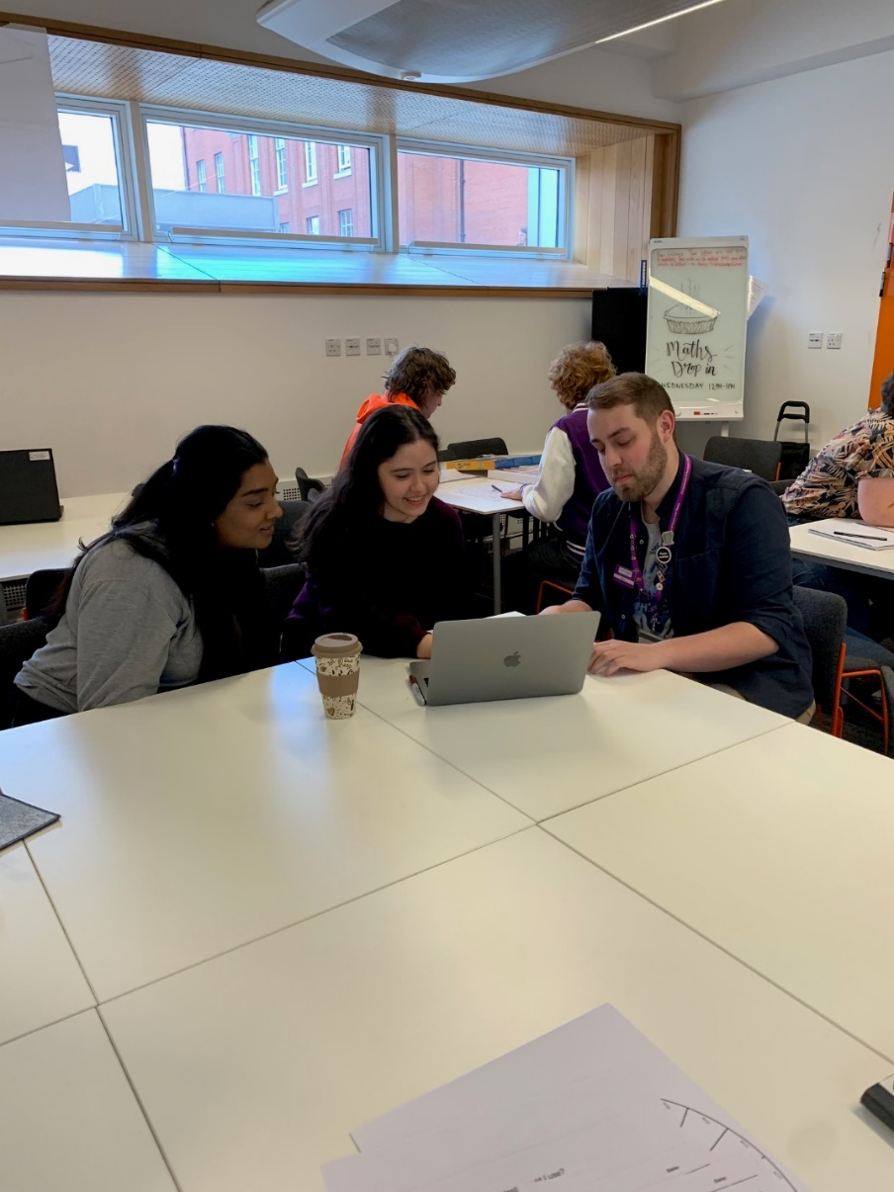
Drop-Ins
Wednesday – Alan Gilbert Learning Commons
12:00 – 13:00
Friday – Main Library (referencing)
14:00 – 15:00

Slide 44
Blackboard image

Slide 45



Help and support
Library Website
www.manchester.ac.uk/library
Library Chat
11am to 3pm, Monday to Friday
Email us
uml.teachingandlearning@manchester.ac.uk

Slide 47


