Slide 1
GEOG60662 Preparing for your dissertation

Slide 2
Coverage
Searching for literature
How to engage critically with literature
Referencing
How to get further help

Slide 3
Write a dissertation to demonstrate:
Knowledge and understanding of a topic
Organise and present your argument
Research a topic
Engage critically with literature
Show that you have an understanding of the topic in question, and are not just presenting everything you know about a topic
Searching for literature
Demonstrate you have researched the question adequately, using good quality sources and referencing them well
Referencing
Make sure that your argument is communicated to the reader in the clearest way possible.

Slide 4
Notes:
You will find support for your academic skills development in the Libraries My Learning Essentials pages – there are online resources that cover the topics from todays session and they will be embedded in your BB space.

Slide 5
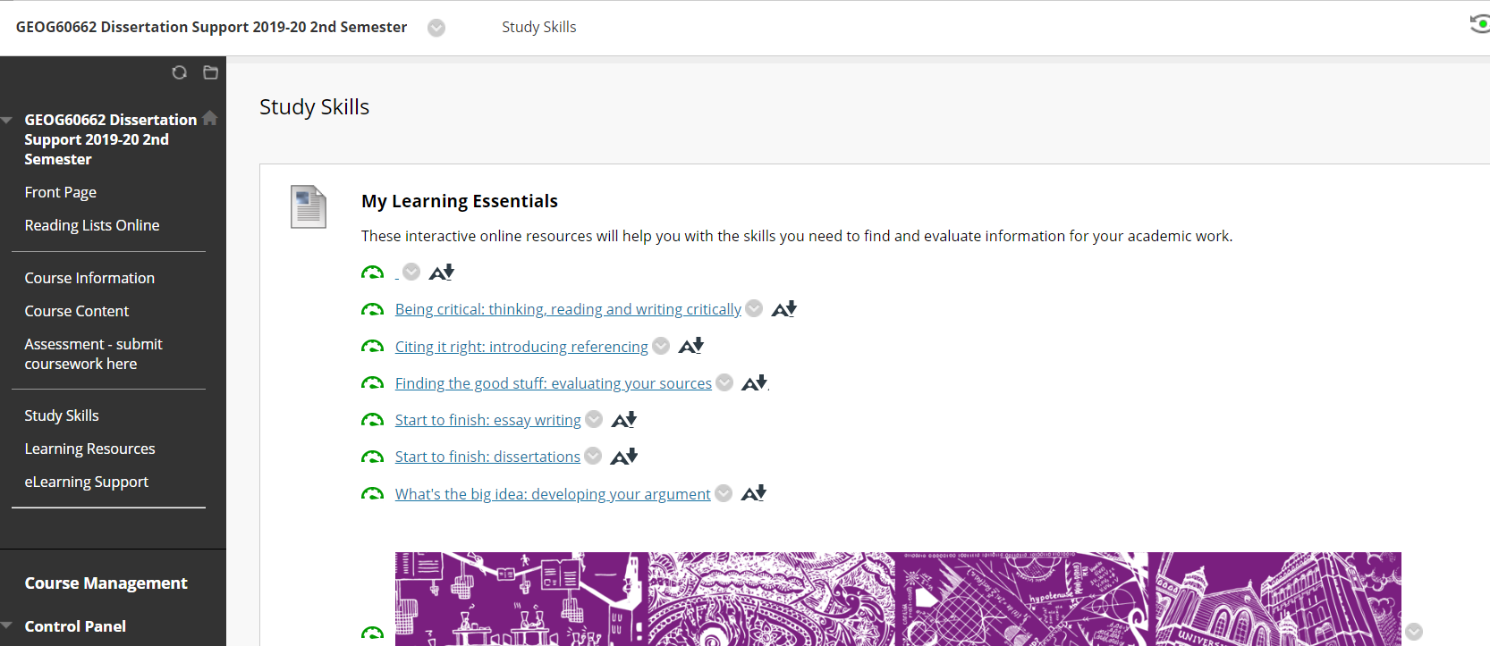
Blackboard – Study skills

Slide 6
Searching for literature

Slide 7
Audience response – Where do you currently look for information for your coursework?
Go to www.menti.com
Notes:
Check code

Slide 8
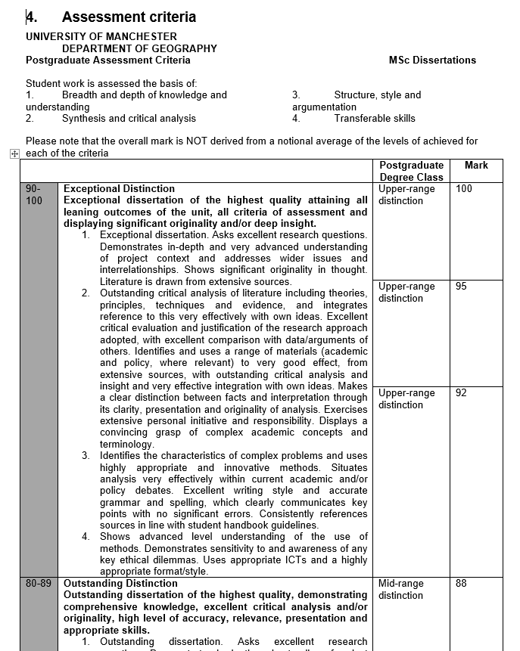
Coursework Grade Description
Upper range - exceptional distinction
Asks excellent research questions
Literature drawn from extensive sources
Originality of thought
Outstanding critical analysis….

Slide 9
Dissertation topic example
Aim: To assess the potential of remote sensing as a tool for monitoring peatland hydrology
RQ 1 How are the spectral characteristics of Sphagnum influenced by changes in soil moisture?
RQ 2 How can spectral indices be used to elucidate variations in near-surface wetness from the spectral reflectance properties of Sphagnum moss?
RQ 3 What is the distribution of Sphagnum, as mapped from airborne imagery?

Slide 10
Activity 1. Map your keywords
Work in groups of 3-4
What keywords and phrases would enable you to find relevant evidence for the suggested title.
One person in the group records all the search terms that you can all think of on their laptop.
Notes:
WHAT keywords do I use to search for good literature?
Using flipchart paper and the pens in groups of 4 take the example title/area from the slide and consider the key ideas that the question is exploring. From the ideas you can begin to select the words and phrases that you would use to type into your Google box to find information that will enable you to locate the ‘news’ or evidence in your field.
Create a mind map/spider diagram to represent all the potential terms that could be used to search for the literature.
How many terms did you find? What is the problem with this? What is the advantage of this activity?
This represents the broadness….but what needs to happen now?
Introduce the traffic light technique of highlighting your keywords and phrases to indicate what you definitely expect to use and what is less relevant.
You will use these shortly to search

Slide 11
Topic title
To assess the potential of remote sensing as a tool for monitoring peatland hydrology

Slide 12
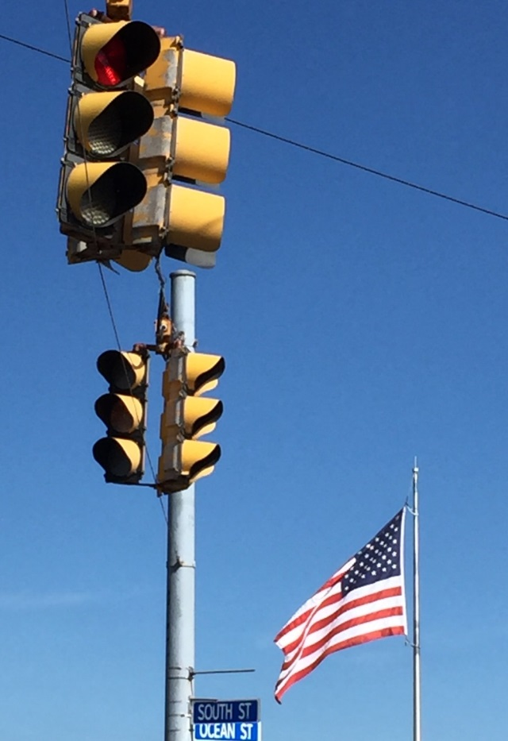
Activity 2. Rank your words & phrases
Highlight the terms that are more likely to be most prominent
using what you know.
Do not want
Possibility
Definitely needed

Slide 13
Seek out key concepts…
To assess the potential of remote sensing as a tool for monitoring peatland hydrology
Notes:
Look at some key concepts within the title

Slide 14
What other keywords could you use?
peatlands; satellites; remote sensing; sphagnum; hydrology; vegetation cover; spectral analysis; image analysis; environmental management; environmental monitoring; infrared rays; satellite communications; spectrophotometry, infrared; water movements; wetlands; moisture stress index

Slide 15
Search Strings can expand/ refine/ exclude
(spectral analysis OR image analysis)
OR expands the search
spectral analysis AND image analysis
AND narrows the search
(spectral analysis AND image analysis) NOT peatland
- NOT refines/excludes a concept (peatland)
Notes:
Begin to batch them into groups

Slide 16
Research tools
Library search
Subject Guides
Google
Scholar

Slide 17
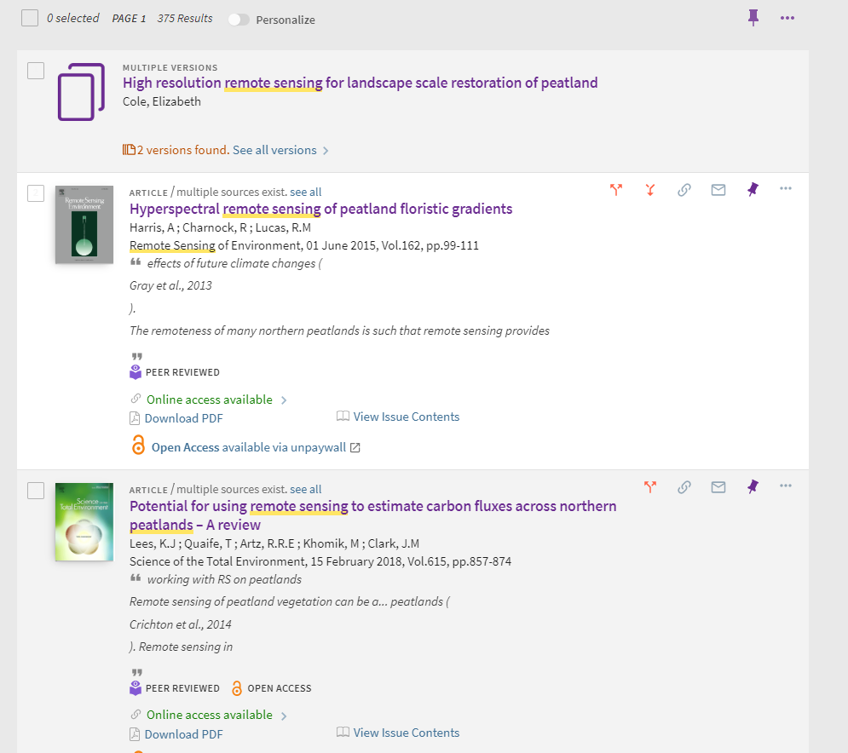
Library search

Slide 18
Geography Subject guide

Slide 19
Key databases
Georef
Agricultural & Environmental Science Collection
Digimap
Web of Science/ Scopus

Slide 20
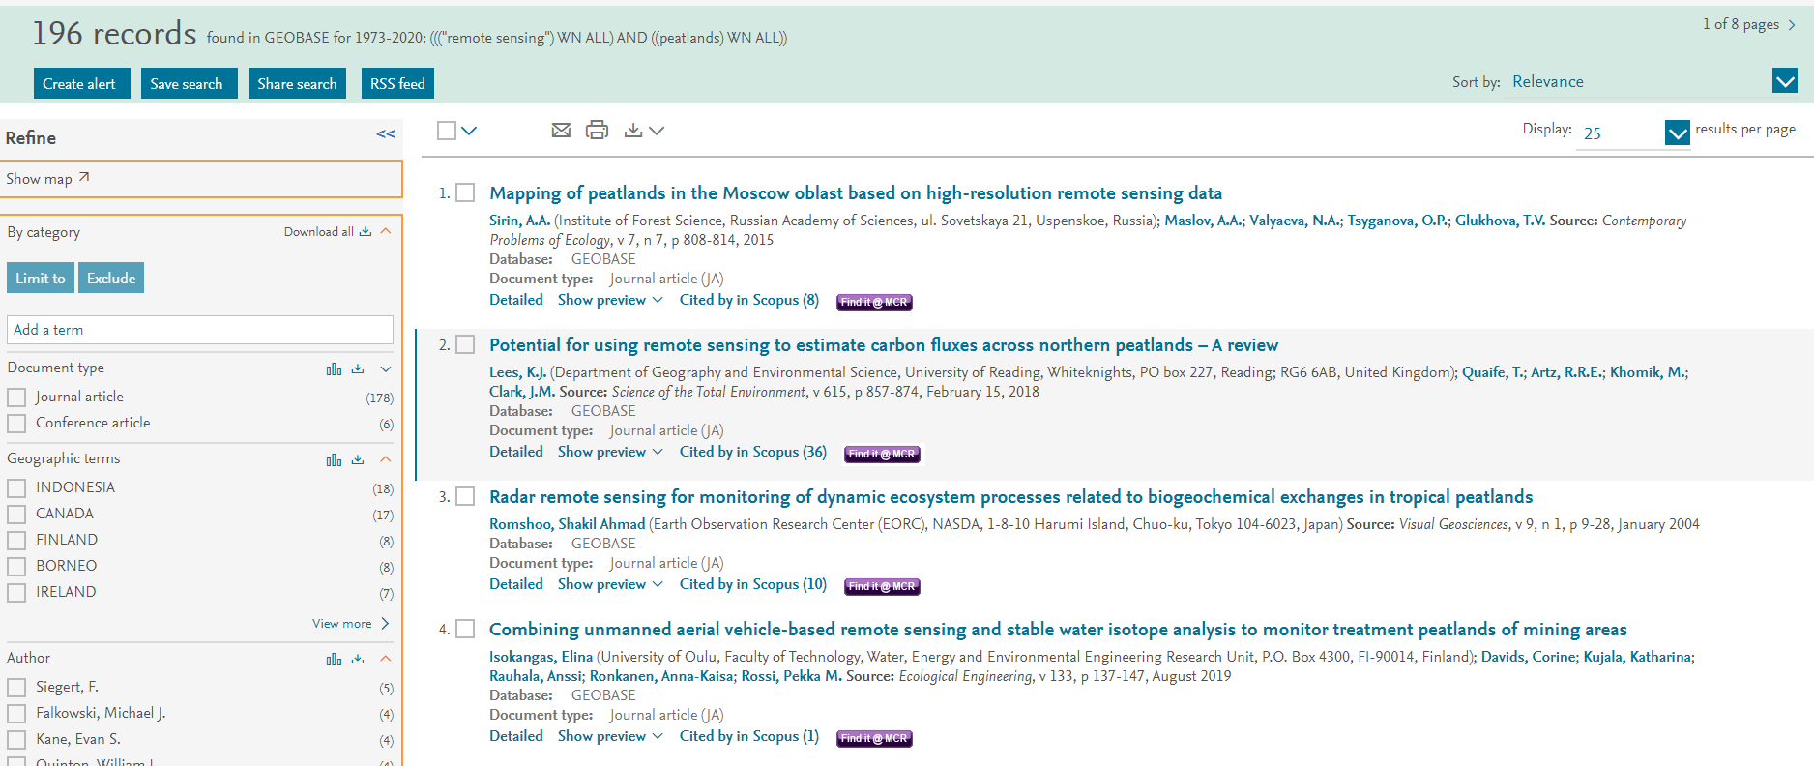
Georef

Slide 21
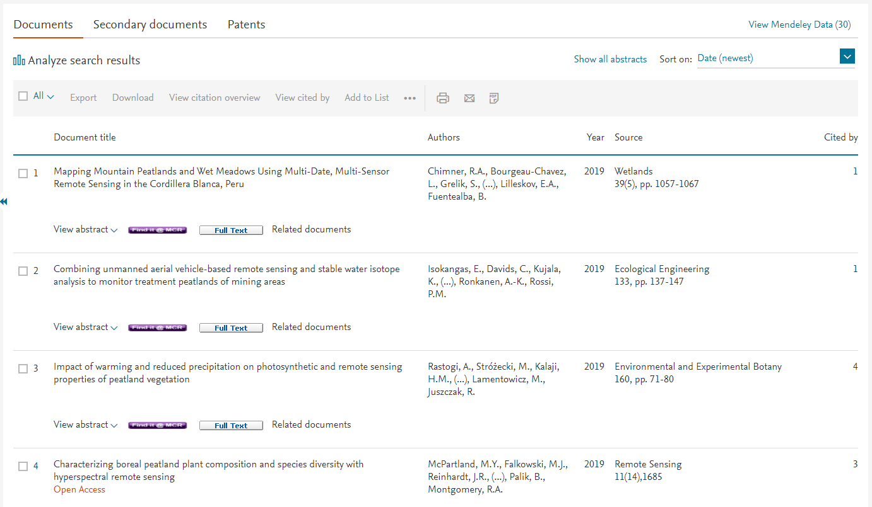
Scopus – search example (31 results)

Slide 22
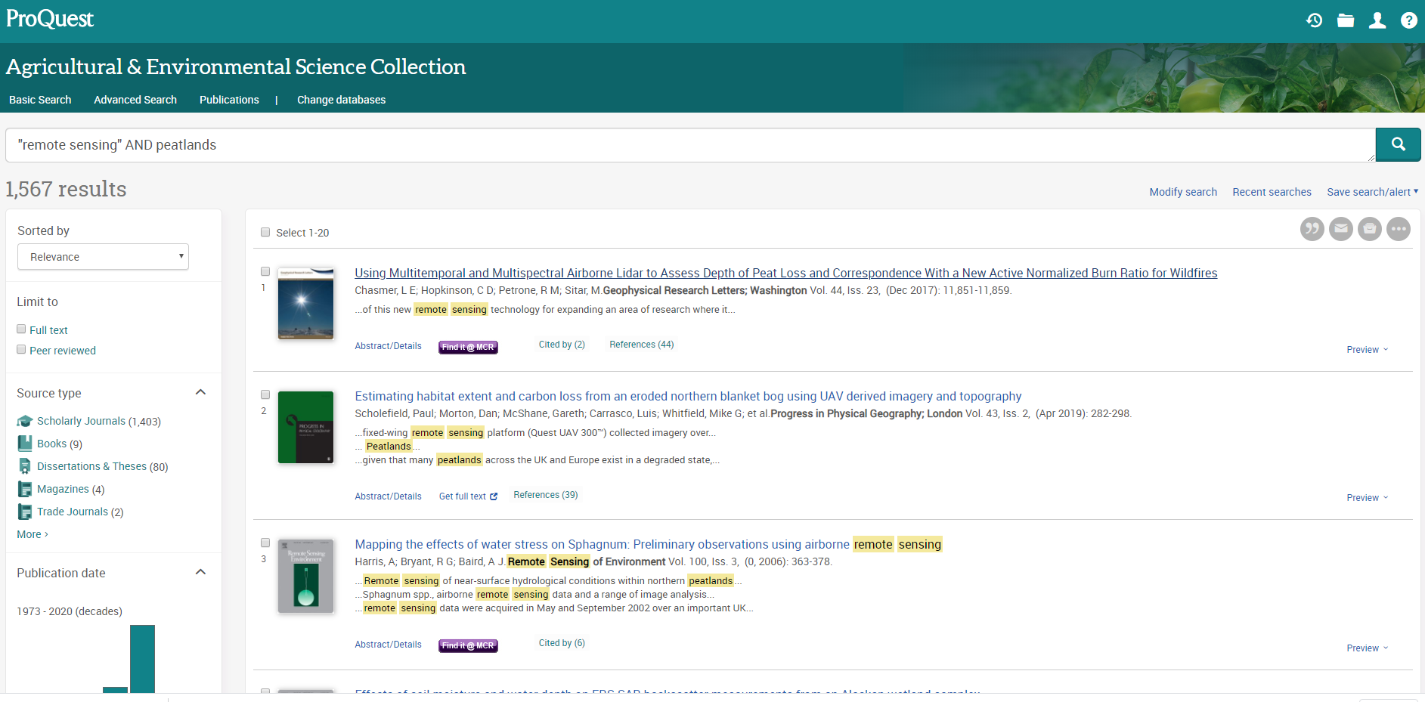
Agricultural & Environmental Science Collection
– search example

Slide 23
Audience response- So why should use these resources?
Go to www.menti.com
Notes:
Check code

Slide 24
Activity 3 - Searching with your keywords
In your groups
Find 3 articles that you think are relevant to the topic question.
Download them
Each group will search a different resource.
15 minutes

Slide 25
Let’s start searching
Group 1 - Library Search
Group 2 - Subject database – Georef/ Agricultural & Environmental Science Collection
Group 3 - Google Scholar
15 minutes

Slide 26
MLE resources to support your searching
Find this in your Blackboard space
Notes:
Add the resources for searching

Slide 27
Critical reading

Slide 28
How being critical relates to your assessment
Upper range - exceptional distinction
Outstanding critical analysis of the literature including theories, principles, techniques and evidence…..
Excellent critical evaluation and justification of the research approach adopted, with excellent comparison with data/arguments of others.

Slide 29
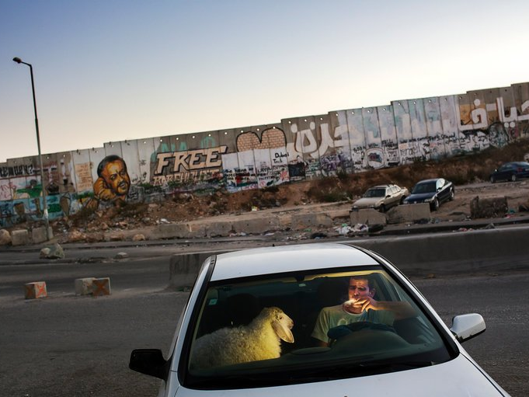
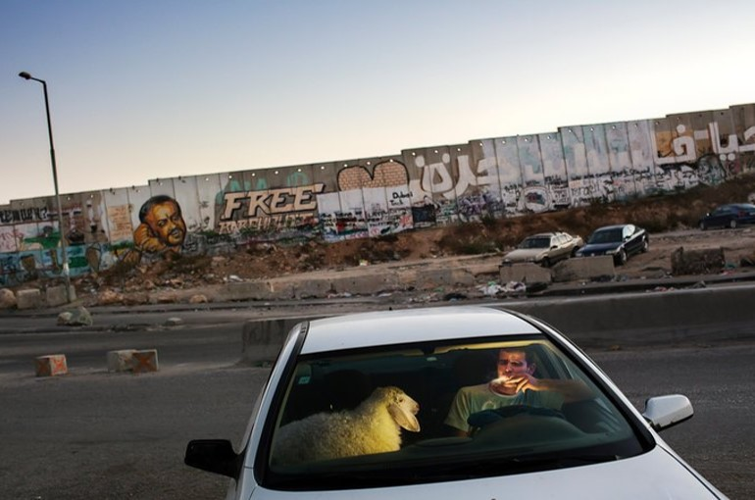
What is happening in this picture?
© Tanya Habjouqa/ Panos Pictures used under UK copyright exception https://www.nytimes.com/2017/02/13/learning/whats-going-on-in-this-picture-feb-13-2017
Notes:
© Tanya Habjouqa/ Panos Pictures used under UK copyright exception. From NYTimes https://www.nytimes.com/2017/02/13/learning/whats-going-on-in-this-picture-feb-13-2017.html?rref=collection%2Fcolumn%2Flearning-whats-going-on-in-this-picture&action=click&contentCollection=learning&region=stream&module=stream_unit&version=latest&contentPlacement=13&pgtype=collection
After grueling traffic at the Qalandia checkpoint, a young man enjoyed a cigarette in his car as traffic finally cleared on the last evening of Ramadan. He was taking home a sheep for the Eid celebration. West Bank.
Students are shown a picture, projected in the front of the room, if possible.
At the top of their paper, students should write: "What is happening in this picture?"
At the bottom of the page, they should answer (very simply, in 1-2 sentences) with what they believe is happening in the photo.
In the middle of the page — and this is why it's called "Gap Fill In" — students write down all of the steps they took to arrive at that answer. Students are encouraged to write down the evidence they see that supports their conclusion.
GOAL: This activity not only uses evidence, but supports meta cognition skills by asking what prior knowledge brought you to your conclusion.
Taken from:https://www.educationdive.com/news/3-activities-to-encourage-critical-thinking-in-the-classroom/250270/
NYTimes
• What is going on in this character/scene?
• What do you see in the text that makes you say that?
• What more can you find?
By looking closely at an image, forming their own interpretations and sharing their ideas, students practiced skills such as making an argument, finding and citing evidence, analyzing various accounts of a subject told in different mediums, making strategic use of digital media and participating in collaborative discussions. https://learning.blogs.nytimes.com/2013/06/03/what-did-you-think-of-whats-going-on-in-this-picture/
“She told us how the practice of finding details to defend their interpretations of each photo improved their academic skills in general, and their science skills in particular:
After practicing with “What’s Going On in This Picture?’ weekly, I started to see my students get much better at using evidence in their writing. For example, in their lab reports, they started to be much more detailed and to explain the context clues that led them to a conclusion.
I remember going over every detail (flags, body language, signs, outfits) with a critical eye. It is truly a rewarding experience, and the limbo of waiting [to find out what’s actually going on in the picture] seemed like it lasted forever.”

Slide 30
Activity: Fill in the gap
Step1: At the top of the page, write:
‘What is happening in the picture?’
Notes:
Elaborate on some of the notes that you made

Slide 31
Activity: Fill in the gap
Step1: At the top of the page, write:
‘What is happening in the picture?’
Step 2: At the bottom of the page:
Write down what you believe is happening in the photo (Be brief, 1-2 sentences max)
Notes:
Elaborate on some of the notes that you made

Slide 32
Activity: Fill in the gap
Step1: At the top of the page, write:
‘What is happening in the picture?’
Step 3: In the middle of the page: Write down all the steps you took to arrive at that answer – where is the evidence?
Step 2: At the bottom of the page:
Write down what you believe is happening in the photo (Be brief, 1-2 sentences max)
Notes:
Elaborate on some of the notes that you made

Slide 33
Thinking critically
“The important thing is to never stop questioning” (Albert Einstein)
Notes:
Elaborate on some of the notes that you made

Slide 34
Critical engagement with the literature
Being critical
Critical thinking
Criticality
What does being critical mean to you?
Go to www.menti.com
CC0 Public domain: https://www.goodfreephotos.com/albums/vector-images/thinking-brain-machine-vector-clipart.png
Notes:
https://www.goodfreephotos.com/albums/vector-images/thinking-brain-machine-vector-clipart.png
Being critical. Critical thinking. Criticality.
What does this mean to you?
Being critical in your literature review doesn’t necessarily mean pulling literature to pieces, you can demonstrate being critical in a number of ways.
When academics talk about “being critical” or “critical thinking”, they are talking about an approach you take to everything you do. It is associated with mainly with questioning things and using these questions to develop your own argument.

Slide 35
Being critical
It is easy to produce a furniture sale catalogue, to collect facts and to describe what is, but not so easy to produce this ‘critical’ review. It involves questioning assumptions, querying claims made for which no evidence has been provided, considering the findings of one researcher versus those of others and evaluating.
Bell, J. and Waters, S. Doing Your Research Project : A Guide For First-Time Researchers, London: McGraw-Hill Education, 2014.
Notes:
Being critical in an academic sense is often confused with criticism. Criticism is the act of judging something, or reacting to it negatively. You might criticise someone’s idea by sending them an ‘um, DUH’ meme like the one pictured. This is not the same as using critical thinking/writing/reading skills.
Being critical in your literature review doesn’t necessarily mean pulling literature to pieces, you can demonstrate being critical in a number of ways.
When academics talk about “being critical” or “critical thinking”, they are talking about an approach you take to everything you do. It is associated with mainly with questioning things and using these questions to develop your own argument.

Slide 36
Being critical
Question and evaluate what you read
Are any claims supported by evidence
Comparison and conflict of the literature
Provide an argument
Contribute new ideas to the debate surrounding your topic

Slide 37
Critical writing
Descriptive writing | Critical/ analytical writing
States what happened | Identifies the significance
States what something was like | Evaluates (judges the value) strengths and weaknesses
Gives the story so far | Weighs one piece of information against another
Says how to do something | Makes reasoned judgements
Explains what a theory say | Argues a case according to evidence
Explains how some thing works | Indicates why something will work (best)
Says when something occurred | Identifies why the timing is important
States options | Gives reasons for the selection of each options
States links between items | Shows the relevance of links between pieces of information
Descriptive versus critical / analytical (writing adapted from Moon, cited in Cottrell 1999:23) University of Nottingham https://www.nottingham.ac.uk/studentservices/documents/description-vs-analysis---learnhigher.pdf

Slide 38
Critical reading is a form of language analysis that does not take the given text at face value, but involves a deeper examination of the claims put forth as well as the supporting points and possible counterarguments

Slide 39
What are you reading for?
Information – for basic facts/formulate ideas
Understanding - for overview/ background reading
Analysis - For more in-depth reading i.e. to find specific facts to support or disprove an argument
CC0 Public domain: https://pixabay.com/en/book-bible-text-literature-2073023/
Notes:
https://pixabay.com/en/book-bible-text-literature-2073023/
We all do a lot of reading in our day to day lives, but we don’t devote the same time and attention to everything we read.
The way you read a novel will be very different to the way you read a notice board. Your approach varies according to your purpose.
There are three main approaches to reading:
Reading for information:
Overview: looking for specific pieces of data
Examples: getting directions, finding opening hours, looking up an author’s date of birth.
Technique: scanning a text to look for keywords or phrases that answer your question,
then moving on.
Reading for understanding
Overview: gaining an overview of an area; gathering general information.
Examples: reading for pleasure, background reading into a topic.
Technique: reading a text once from start to finish, often passively.
Reading for analysis
Overview: engaging your prior knowledge and actively applying it to what you’re reading.
Examples: reading for an essay, dissertation, literature review or thesis.
Technique: reading a text actively multiple times, asking questions of the text. This is
critical reading; we will examine a strategy in more detail in this section.

Slide 40
Note-taking – Cornell Notes
Key facts/ dates etc. | Main notes
 | Summary
Notes:
Elaborate on some of the notes that you made

Slide 41
Searching return
To assess the potential of remote sensing as a tool for monitoring peatland hydrology
Open up a pdf.
Would you use it in your coursework?
Why would you use it in your coursework?

Slide 42
Question! Question! Question!
Critical reading
Critical thinking
Notes:
When reading critically, you are trying to establish the validity and significance of a text.
Critical reading is much like being a judge at a trial; you must cross examine the arguments of other scholars. Remember these arguments are subjective, much like a witness testimony in court.
By questioning everything you read in this way, examining all pieces of evidence and how they relate to each other, you can make a critical decision about the validity and relevance of the arguments made.
What questions do you need to ask to make a decision on the truth of the testimony?
• What is it claiming?
• What are the reasons for making that claim?
• Do any other witnesses support/corroborate the testimony?
• Does the testimony support the overall case?
• How does the testimony relate to the other witnesses?
By questioning every witness in this way, you can ensure you see all sides of the case. Using the evidence available and examining how they relate to each other, you can make a critical decision on the validity and relevance of the testimony

Slide 43
What else do you need to keep?
Details of the paper so that you can find it again and reference it
Relevant quotes/data that you will use
Your thoughts on the paper – evaluation, what it means to your project
Summary of the paper
Notes:
Elaborate on some of the notes that you made

Slide 44
MLE resources to support your searching
Find this in your Blackboard space
Notes:
Add the resources for searching

Slide 45
Break time
5 minute break

Slide 46
How referencing relates to your assessment
Upper range - exceptional distinction
Identifies and uses a range of materials (academic and policy, where relevant) to very good effect, from extensive sources, with outstanding critical analysis and insight and very effective integration with own ideas
Makes a clear distinction between facts and interpretation through its clarity, presentation and originality of analysis
Consistently references sources in line with student handbook guidelines.

Slide 47
Audience response- how many references should you use in your dissertation?
Go to www.menti.com
Notes:
Check code

Slide 48
A non-prescriptive strategy!
25%
43%
32%

Slide 49
It Says/I say/And So
What people said
Why is this significant?
What changes?
What do I think about what they said?

Slide 50
A gentle reminder…
There are a number of problems and inconsistencies with Kolb’s learning styles
Plagiarism risk
Notes:
if you took information from a source and included like this slide then….

Slide 51
A gentle reminder…
Garner (2000) highlighted a number of problems and inconsistencies with Kolb’s learning styles
Garner, I. (2000). ‘Problems and Inconsistencies with Kolb's Learning Styles’, Educational Psychology 20:3, pp.341-348.
Correctly attributed
Notes:
Correctly attributing the source and incorporating it into your work !

Slide 52
It says
I say
& so
Garner (2000) highlights a number of problems with the psychological foundations of Kolb’s theory of learning styles…
Kolb is a key proponent of incorporating learning styles into instructional design…
Teaching according to learning style can limit student’s ability to adapt…

Slide 53
Incorporating the work of others smoothly
Quote: use when the original words will only do and you want to make an impact.
Paraphrase: use when you are re-writing another writer’s words or ideas in your own words without altering the
meaning. (your version would be about the same as the original)
Summarise: is putting down the main ideas of someone else’s work in your own words. (shorter than the original – only includes the main points)

Slide 54
University of Manchester phrase bank
http://www.phrasebank.manchester.ac.uk
http://commons.wikimedia.org/wiki/File:2004-02-29_Ball_point_pen_writing.jpg
Notes:
Can we just embed this in the BB space?

Slide 55
Help and support
Library Website www.manchester.ac.uk/library
Library Chat 9am to 5pm, Monday to Friday
Email us uml.teachingandlearning@manchester.ac.uk
Notes:
There are a number of ways to seek support after the session so please get in touch

Slide 56
MLE resources to support your searching
Find this in your Blackboard space
Notes:
Add the resources for searching

Slide 57
My Learning Essentials: Start to Finish Essay Writing Available via Blackboard (Essay writing workshop section)
Topic Sentences & Paragraph Structure http://www.northwestern.edu/climb/resources/written-communication/Creating-Coherent-Paragraphs.html
Learn Higher, Essay Writing Pack http://www.learnhigher.ac.uk/writing-for-university/academic-writing/essay-writing-pack/
Greasley, P. (2016). Doing Essays & Assignments. 2nd Edn. London: Sage Publications Inc.
Pears, R. & Shields, Graham J, 2010. Cite them right : the essential referencing guide 8th ed., Basingstoke: Palgrave Macmillan.

Slide 58
Do you think what you learned in this session will be useful to you in the future?
Yes
No

