Slide 1
LAWS70311
Thinking critically about your sources

Slide 2
Today’s session
Finding information
Evaluating information

Slide 3
Our topic
“Race and the criminal justice system”

Slide 4
Creating a research question
In groups discuss what questions might you ask and answer on:
“Race and the criminal justice system”
Go to www.menti.com and enter: 27 67 22
Notes:
For the purpose of today’s session I would like you to think about the research questions you might ask on this topic. We will use these research questions when we start looking for information.

Slide 5
Creating a research question
Notes:
For the purpose of today’s session I would like you to think about the research questions you might ask on this topic. We will use these research questions when we start looking for information.

Slide 6
Finding information
WHAT am I looking for?
Notes:
Spending a little extra time considering your plan of action will save you a lot of time (and effort) in the long run. As yourself – what information am I looking for? What pieces of information will help you to put the patient advice leaflet together?

Slide 7
Finding information
Talk to the people next to you about the types of information you might find on this topic
Go to www.menti.com and enter code: 27 67 22
Notes:
Talk to the people next to you about the types of information that might be useful when researching this topic

Slide 8
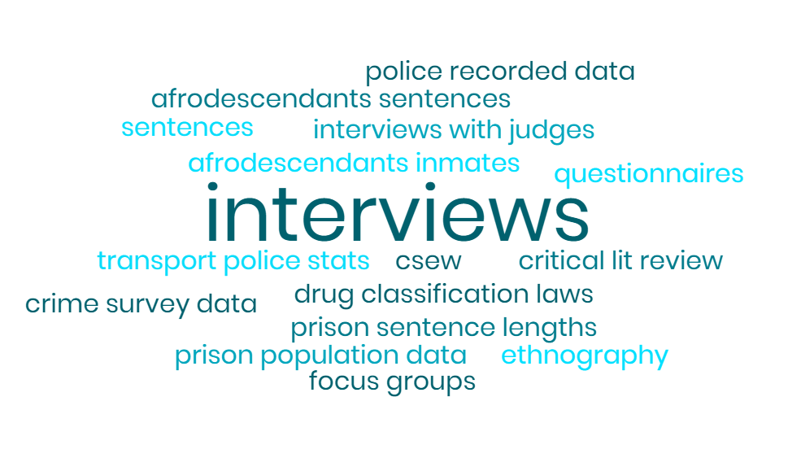
Finding information
Notes:
Talk to the people next to you about the types of information that might be useful when researching this topic

Slide 9
Finding information
Types of information you might use:
Journal articles
News articles
Books and textbooks
Reports and websites
Data and statistics

Slide 10
Types of information
Notes:
The know your sources resource helps you to identify and understand different sources of information.

Slide 11
Types of information
Notes:
The resource gives you key information on different types of information source and how you might make use of them in your own work.

Slide 12
Finding information
WHERE will I look for it?
Notes:
Once you have identified the types of information that are useful to your project you can start thinking about where to look for them.

Slide 13
Finding information – Library Search
Notes:
Library Search is the Library’s main search tool and often a good place to start when searching. You can find it at www.library.manchester.ac.uk or through your My Manchester space.

Slide 14
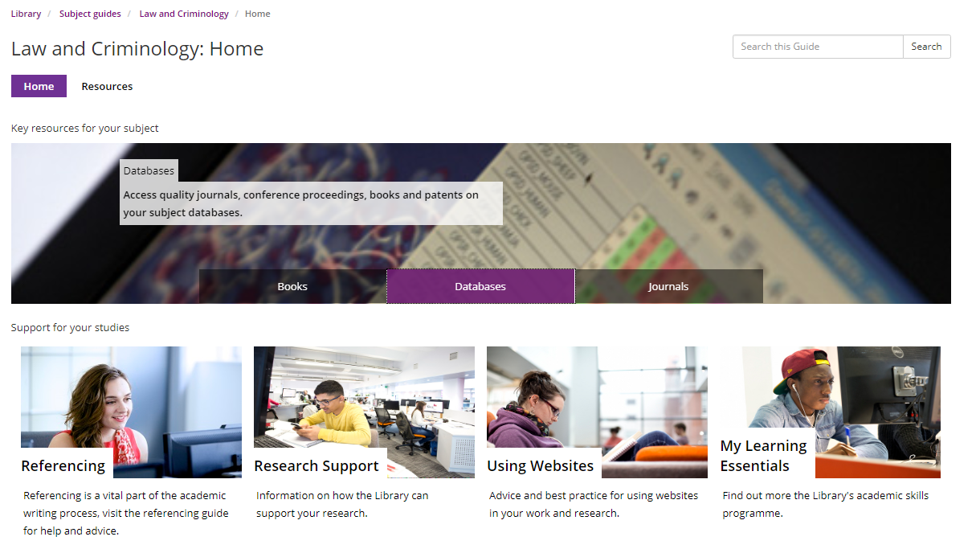
Finding information – subject resources
Notes:
You can find your subject guide through My Manchester or at http://subjects.library.manchester.ac.uk/
By going to the databases section you can find information sources specific to different areas of your subject.

Slide 15
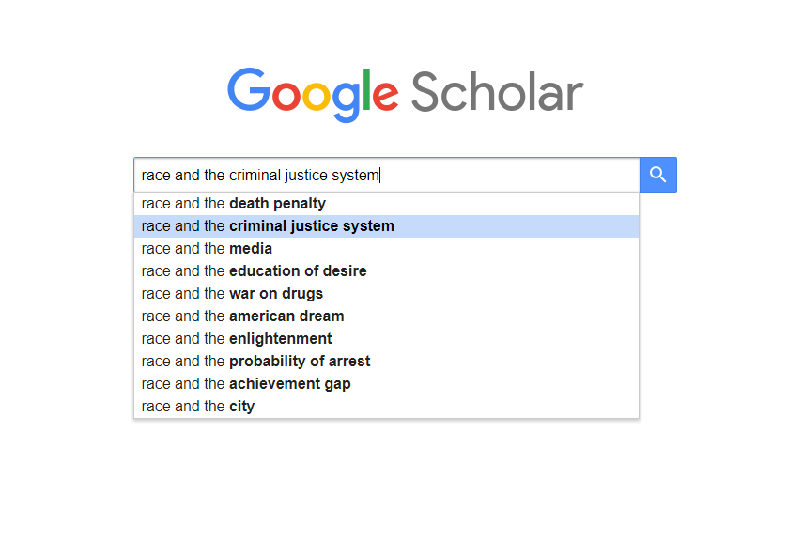
Finding information – Google Scholar
Notes:
Google Scholar is a good tool when you are exploring your subject. It returns only scholarly sources, such as journal articles and academic books. It is difficult to narrow down your search but is a good place to start.

Slide 16
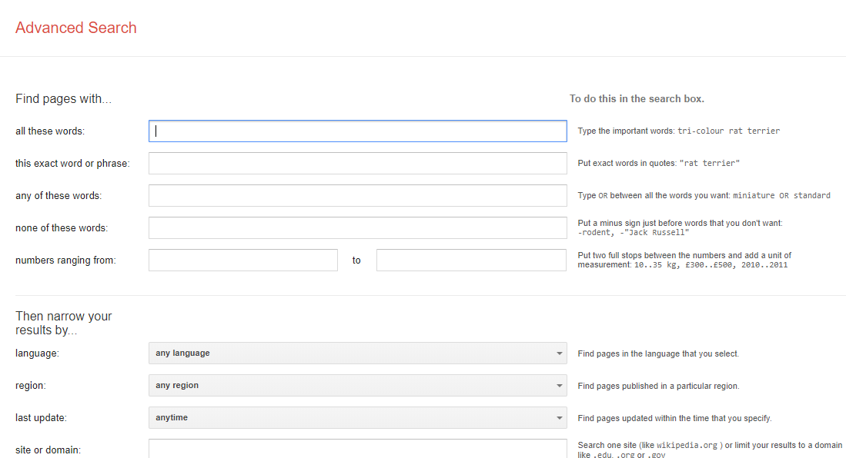
Finding information – Google advanced search
Notes:
Google’s advanced search allows you to apply a number of conditions to your search that you can’t do with Google’s normal search tool. When searching for reports, for example, you can limit your search to a particular domain (eg, .gov.uk) and to a particular format (eg, PDFs). You can find Google’s advanced search options here: https://www.google.co.uk/advanced_search

Slide 17
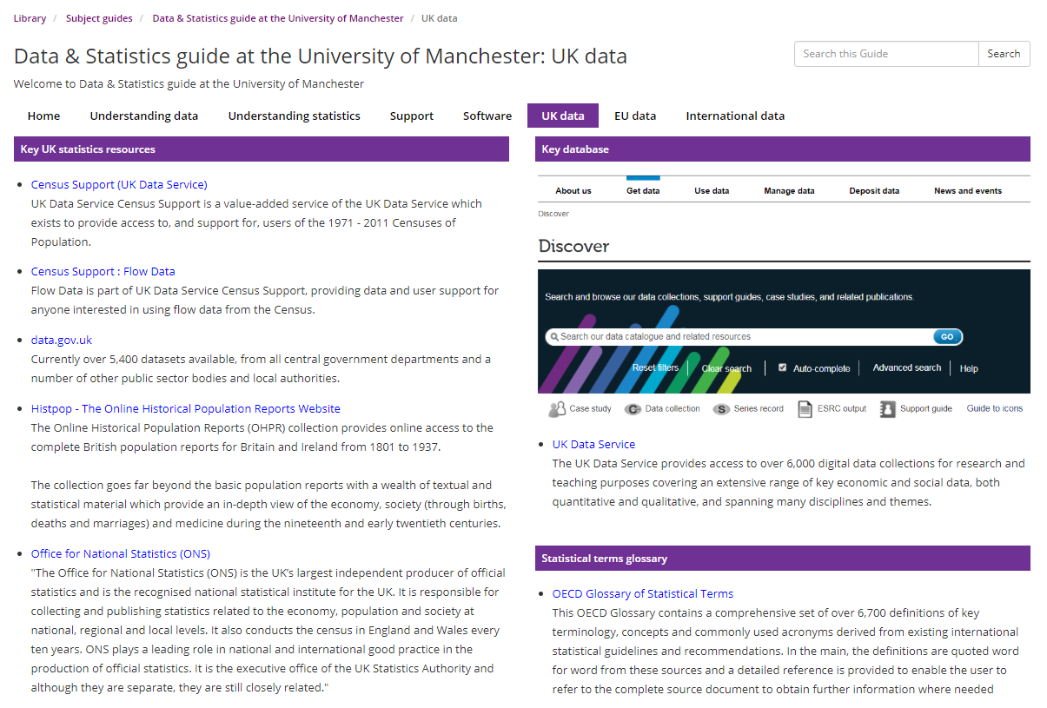
Finding information – data and statistics
Notes:
You can find lots of useful sources of data on the Library’s data and statistics subject guide: http://subjects.library.manchester.ac.uk/data/

Slide 18
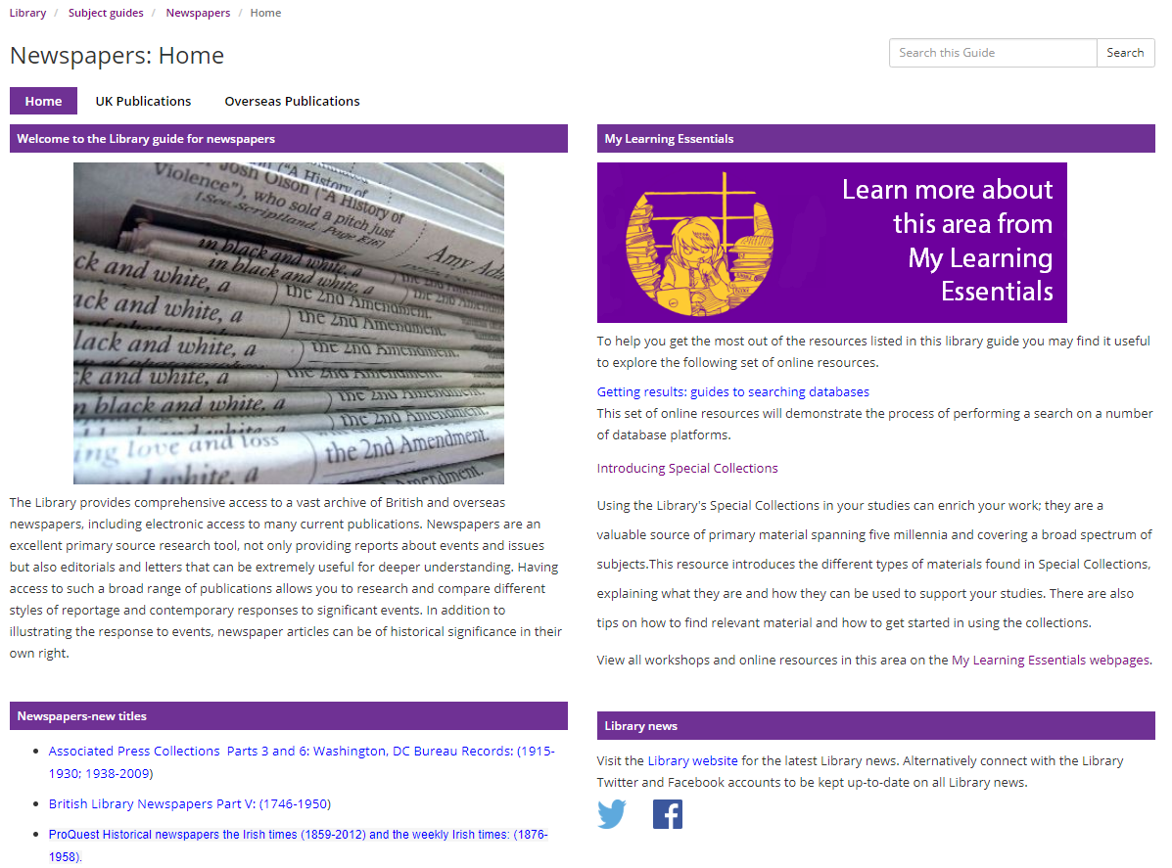
Finding information – news articles
Notes:
You can find a wide range of news sources on the Library’s newspapers subject guide: http://subjects.library.manchester.ac.uk/newspapers
I personally find Factiva (for both UK and international publications) particularly useful, as it allows you to search carefully across an extensive range of publications.

Slide 19
Finding information – other sources
Thinking outside of the box:
What might the comments on a YouTube video of a police incident tell me?
How might the subject of tweets by Greater Manchester Police be interesting?
Notes:
You can find a wide range of news sources on the Library’s newspapers subject guide: http://subjects.library.manchester.ac.uk/newspapers
I personally find Factiva (for both UK and international publications) particularly useful, as it allows you to search carefully across an extensive range of publications.

Slide 20
Finding information
Activity:
In small groups, use each of the search tools to find information on your research question to do with ‘race and the criminal justice system’
www.padlet.com/TandL/laws70311

Slide 21
Our topic
“Race and the criminal justice system”

Slide 22
Evaluating information
Reliability: how trustworthy is the source?
Objectivity: how neutral is the source?
Relevance: how applicable is the source?

Slide 23
Evaluating information – six questions
What type of information is presented?
Why was the source produced?
When was it published or updated?
How was the information produced?
Where was it published?
Who produced the information?

Slide 24
Evaluating information
Activity:
For each source, use the six questions to evaluate whether the source is reliable, objective and relevant

Slide 25
Referencing guide

Slide 26
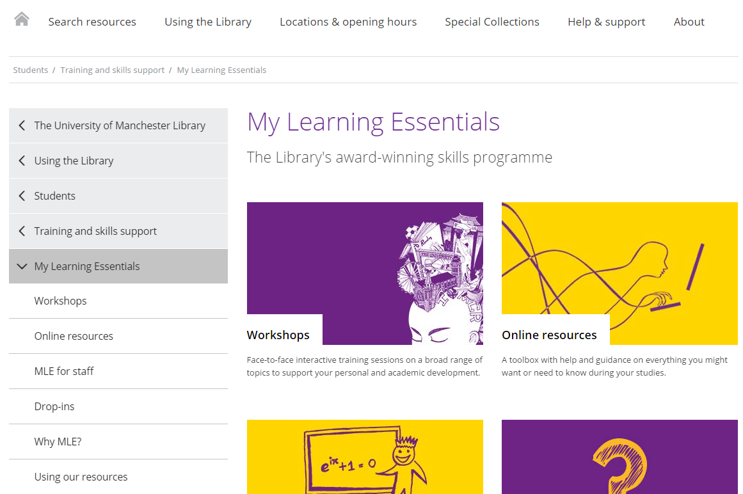
My Learning Essentials
Slide text

Slide 27
Help and support
Library Website www.manchester.ac.uk/library
Library Chat 9am to 5pm, Monday to Friday
Email us uml.teachingandlearning@manchester.ac.uk
Notes:
There are a number of ways to seek support after the session so please get in touch.

Slide 28
Help and support
1. General drop-in:
Wednesdays, 12 – 1, -104 Alan Gilbert Learning Commons
2. Referencing drop-in:
Fridays, 2 – 3, Ground Floor Main Library

Slide 29
Do you think what you learned in this session will be useful to you in the future?
Yes
No

