Slide 1
Dentistry Year 4
Critically Appraised Topic

Slide 2
Workshop schedule
Recognise the types of evidence that are available to you
Identify the tools that are available to you to find high quality evidence
Plan a literature search

Slide 3
Consider the following…
What to record/make notes about
Recognise the terminology being used
Recognise the depth of information required for your CAT

Slide 4
What do you use to find information?
Go to www.menti.com
Enter code 88 92 04

Slide 5
Search strategy
WHAT am I looking for?
WHERE will I look for it?
HOW will I look for it?

Slide 6
Example title
Oral appliances and functional orthopaedic appliances for obstructive sleep apnoea in children
Notes:
To add in the example CAT topic

Slide 7
Keywords/phrases
Step1: In pairs discuss the words and phrases that you would use to answer the research question on the following slide.
Step 2: Consider Population Intervention Comparison Outcome
PICO
Step 3: Write one word or phrase on one post-it
Step 4: Stick them on the appropriate flip chart paper

Slide 8
Keywords/phrases
Step1: In pairs consider where you will look for evidence and what you would hope to find write them down
Step 2: Retrieve a selection of post-its and stick them on the paper to make a search string
Step 3: What can you add to help your string work?
Step 4: Write down anything further that will facilitate your search (see the following slide)

Slide 9
Identification of your studies
Boolean
Limiters
Using AND OR NOT to broaden and narrow your search
Can be used with individual words/phrases or saved searches
Language
Population
Type of study
Date of publication

Slide 10
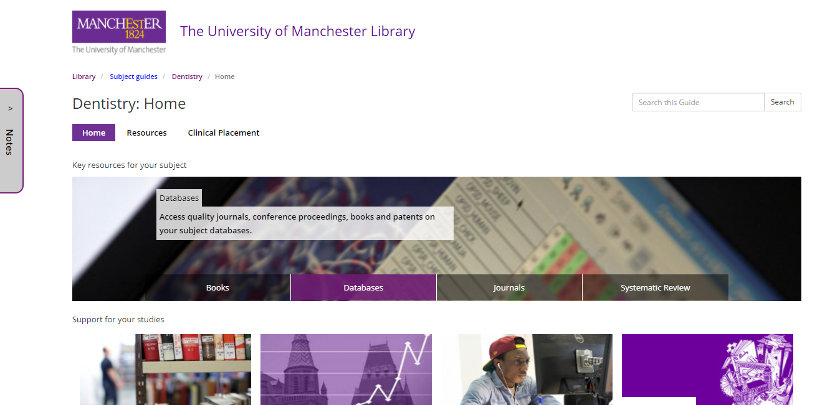
Find your databases

Slide 11
Have I got what I need?
Are the studies I have relevant?
Are the studies of a high quality?
Can I write up how I found them?

Slide 12
My Learning Essentials
Slide text
Notes:
Plenty of further help and support available throughout your studies.
Face to face workshops covering a range of skills and topics.
Online resources which you can access at any time from any where. You can complete these as many times as you like in your own time, they tend to take around 20 mins each to work through.

Slide 13
Drop ins
Wednesday – Alan Gilbert Learning Commons
12:00 – 13:00
Friday – Main Library (referencing) 14:00 – 15:00
uml.teachingandlearning@manchester.ac.uk

Slide 14
Do you think what you learned in this session will be useful to you in the future?
Yes
No

